Slide 1



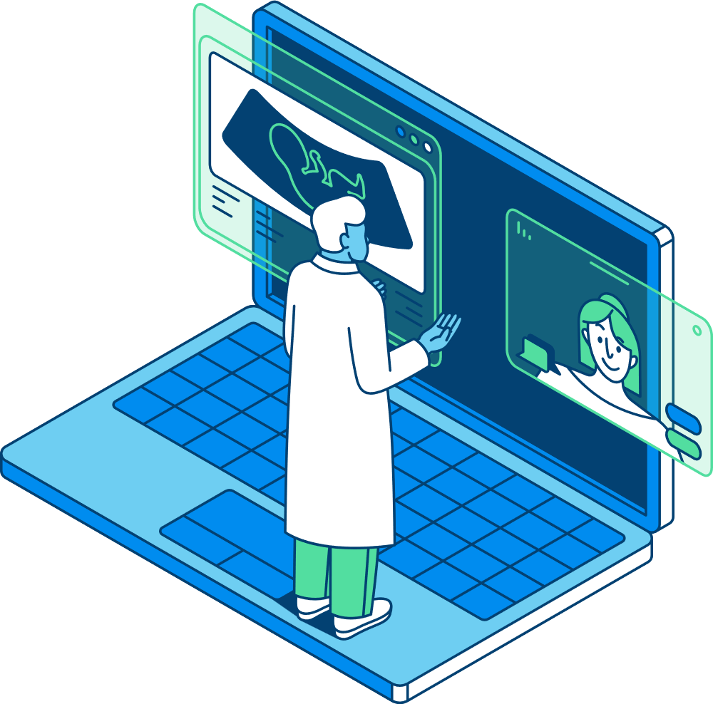


SMART
HEALTH
Smarth Health Digital Hub Vilnius
www.smarthealthdih.eu
NOMEDA ŠIMBELYTĖ

Slide 2



Vision
To be a leading digital health innovation hub, transforming healthcare through smart technologies
Mission
To connect healthcare professionals, researchers, and technology experts in a dynamic ecosystem that drives digital transformation

Slide 3




About us
We are committed to driving innovation in digital health. Our mission is to connect healthcare professionals, researchers, and technology experts to develop cutting-edge solutions.
With our expertise and strong network, we foster collaboration, support digital transformation, and ensure the successful integration of smart health technologies.
The impact we create in advancing healthcare is our greatest motivation, and we continuously strive to push the boundaries of digital health for a better future
www.smarthealthdih.eu

Slide 4

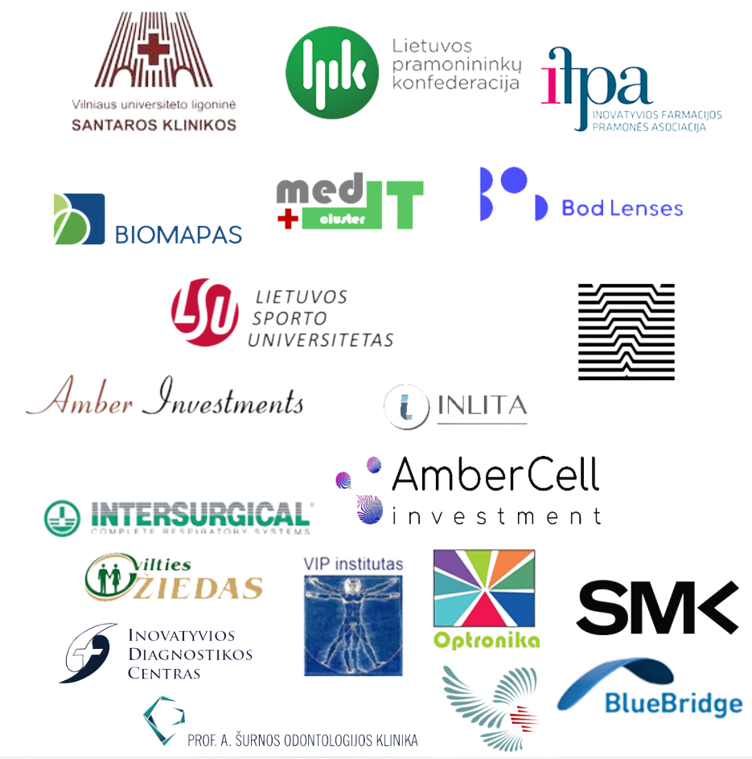




















smart health dih
partners
Leading institutions in various fields
www.smarthealthdih.eu

Slide 5

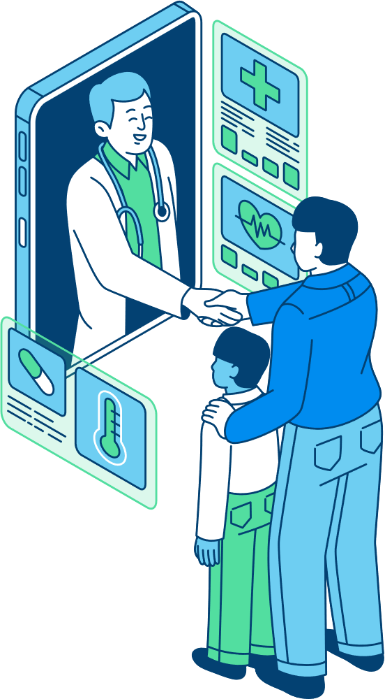


work with ADOLESCENT MENTAL health trials
IN COLLABORATION WITH LEADING INSTITUTIONS
TF-TBC IMPLEMENTATION
DIGITAL APPLICATION CREATED
We digitalized a methodology for assessing children's traumatic experiences and symptoms, gaining valuable experience in handling sensitive adolescent mental health data while ensuring anonymization and strengthening cybersecurity in adolescent digital health solutions
We developed a tailored digital application as part of the TF-CBT implementation project
ACCESS TO ADOLESCENTand child HEALTH DATA
https://www.norwaygrants.lt

Slide 6






work with ONCOLOGY SPECIALISTS
implementation of various digital tools for
Doctors - shared decision making,
Nurses - problem solving
Caregivers - remote empowerment
TRANSITION
tRAINING PROGRAM DEVELOPED
The project created a tailored program, which equips healthcare professionals and non-professionals with the necessary digital skills to improve patient cancer care processes
Patient remote management
Digital interventions implementation (AI, GDPR, cybersecurity)
in collaboration with 24 partners
https://www.europeancancer.org/eu-projects/impact/resource/transition.html
Notes:
surašyti modules

Slide 7




work with coachING process digitalization
tRAINING PROGRAM DEVELOPED
Enhancing their digital skills and exploring innovative solutions.
Ai usage field
We conducted an analysis of various digital coaching applications to assess their effectiveness in coaching. Based on our findings, we developed specialized training modules tailored to enhance coaches' digital competencies.
For improved diagnosis
cybersecurity implementation
https://www.lsu.lt/en/international-cooperation/digitalization-in-the-coaching-process-across-nordic-baltic-countries-nphz-2022-10033/

Slide 8

core services
Test Before Invest
Providing businesses and organizations with the opportunity to trial digital solutions before making full investments.
Skills and Training
Offering education and upskilling programs to enhance digital competencies.
Smart Health DIH is partner of EDIH Vilnius consorcium which is dedicated to accelerate digital transformation of SMEs and public sector organizations in the Vilnius region. We specialize in artificial intelligence (AI), high-performance computing, and cybersecurity
Support to Find Investments
Assisting in identifying funding opportunities for digital transformation.
innovation networking
Connecting stakeholders to foster collaboration and knowledge exchange.
https://www.edih.lt

Slide 9


our main Areas of Expertise
Artificial Intelligence and Decision-Making
Smart Health and Med Tech
  Expertise in medical device regulations and validation
  Algorithms and technical solutions for personalized health monitoring (anomal detection, alert generation, recommendation systems tailored to individual patient needs)
  Access to patients behaviour & health data, medical images
  AI-based analytics and automation
  AI-driven decision support systems
  High-performance computing solutions
Cybersecurity
Robotics
  Cyber threat assessment and risk mitigation
  Data protection and privacy compliance
  Cybersecurity training and awareness
  Industrial and collaborative robotics
  Automation and robotic process optimization
  AI-powered robotic systems for health sector
Notes:
surašyti modules

Slide 10

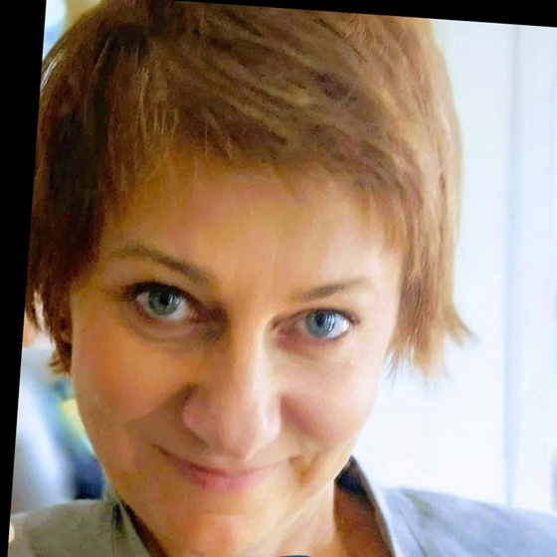


contacts
mrs. nomeda simbelyte
Innovation expert
Phone :
+370 612 79169
Mail:
info@smarthealthdih.eu
www.smarthealthdih.eu

