Slide 1

Örebro University
Diego Montiel Rojas, PhD
Lorenz Webersberger, MSc

Slide 2
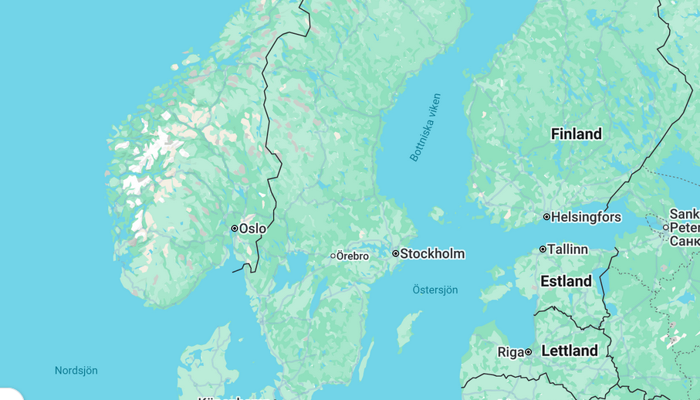

Slide 3

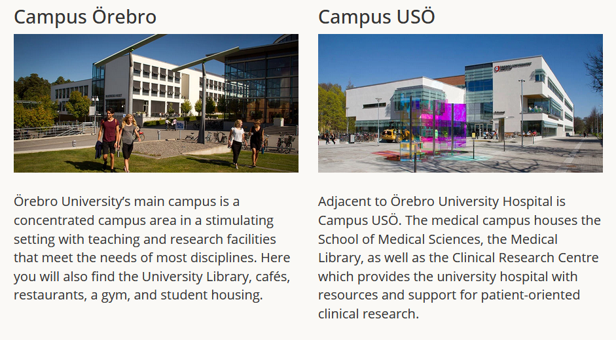
Sport Division at Örebro University

Slide 4
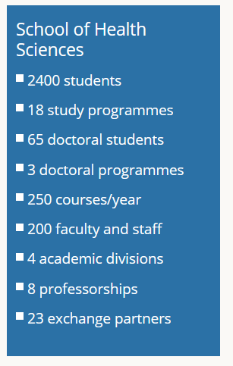

Sport Division at Örebro University

Slide 5
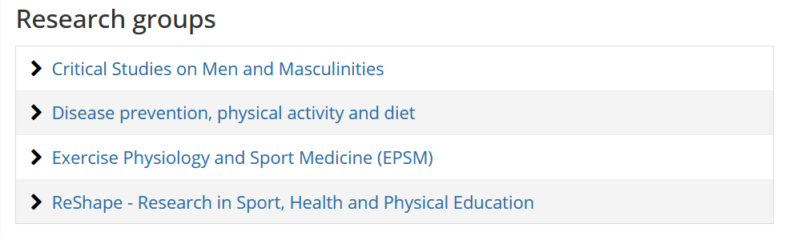
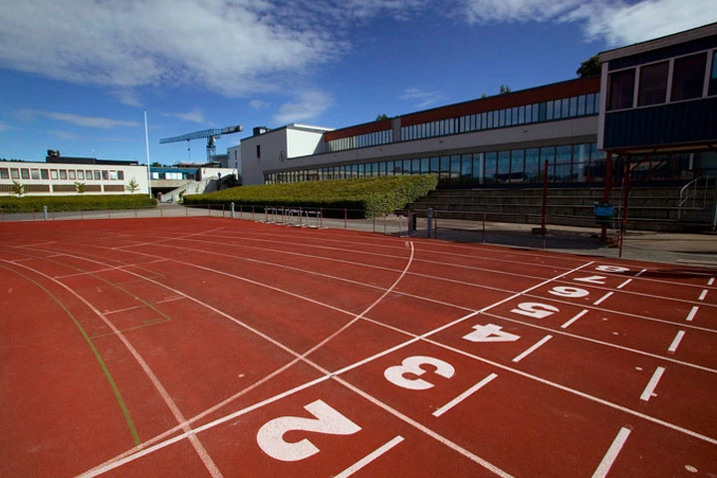
Sport Unit within the School of Health

Slide 6
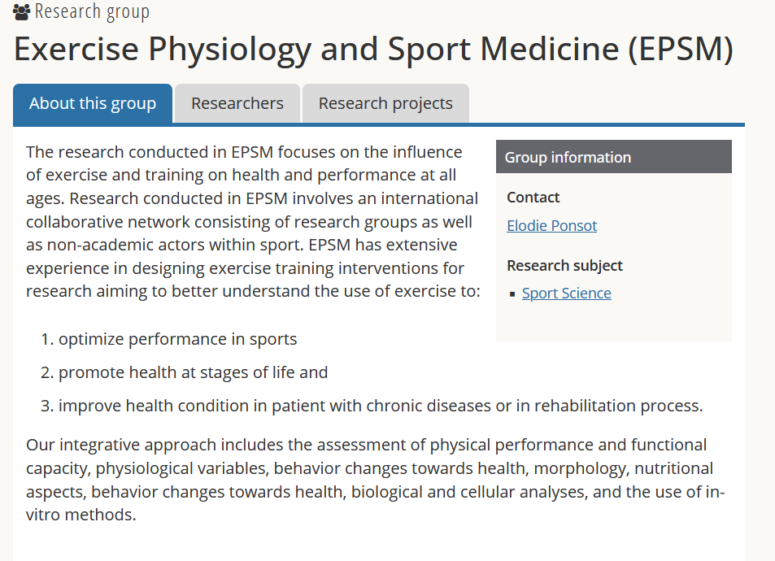
Sport Unit within the School of Health

Slide 7
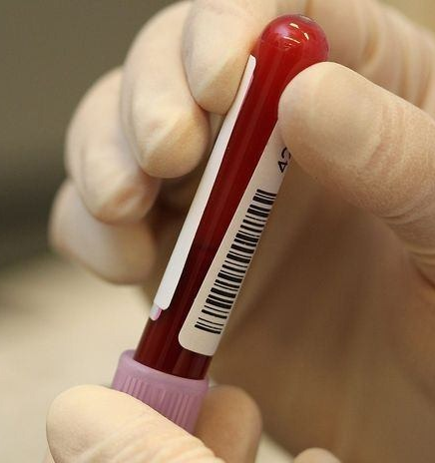
Area of Expertise (for Nordplus)
Sports Physiology and Medicine
  Molecular (self / collaborations)
  Physiological testing (test / field)
  Data Visualisation (Power BI)
Performance
  Team Sport
  Female Athletes
  Training optimisation
This Photo by Unknown Author is licensed under CC BY-NC-ND

Slide 8
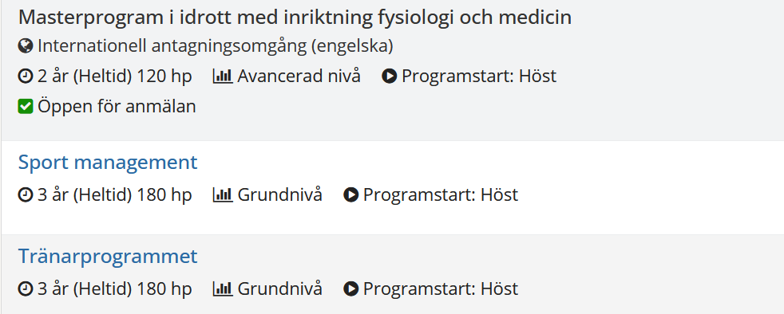
Sport Unit within the School of Health

Slide 9




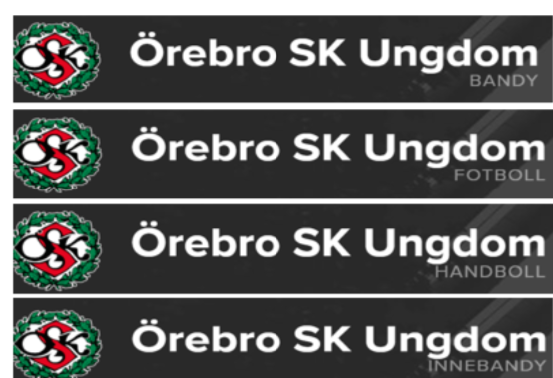


Industry partners
and more to come….

Slide 10
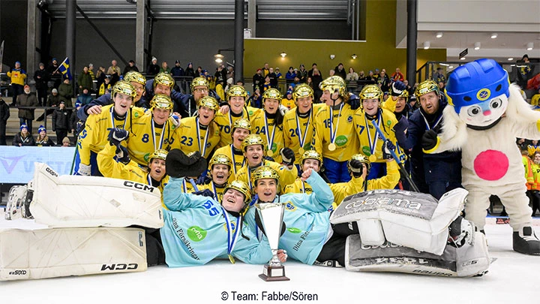
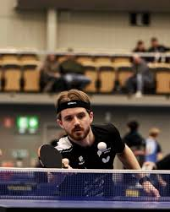
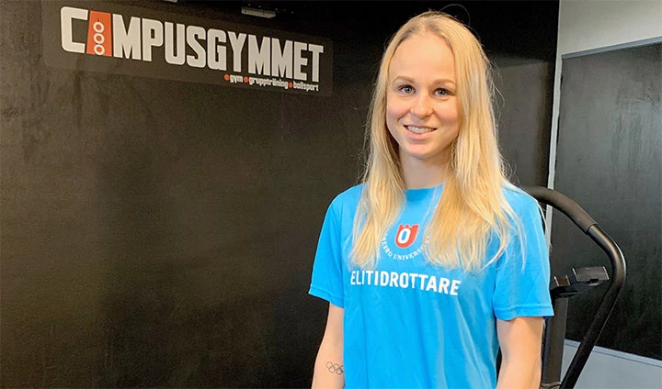
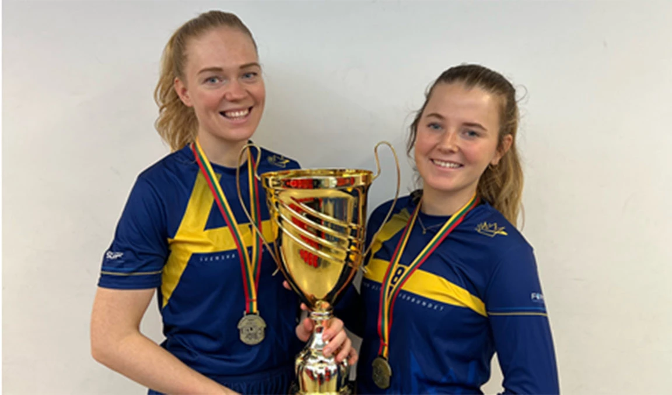
EVL (upgrading maybe?)

Slide 11
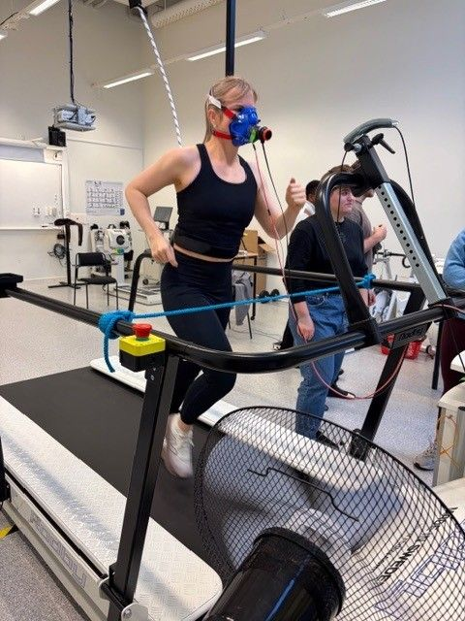
Available Resources (upgrading)
Dedicated molecular laboratory and col.
Dedicated physiology laboratory and col.
Dedicated recovery / BC room
Portable testing capabilities
Possibility to complement with Internationalization and Research support internally

Slide 12
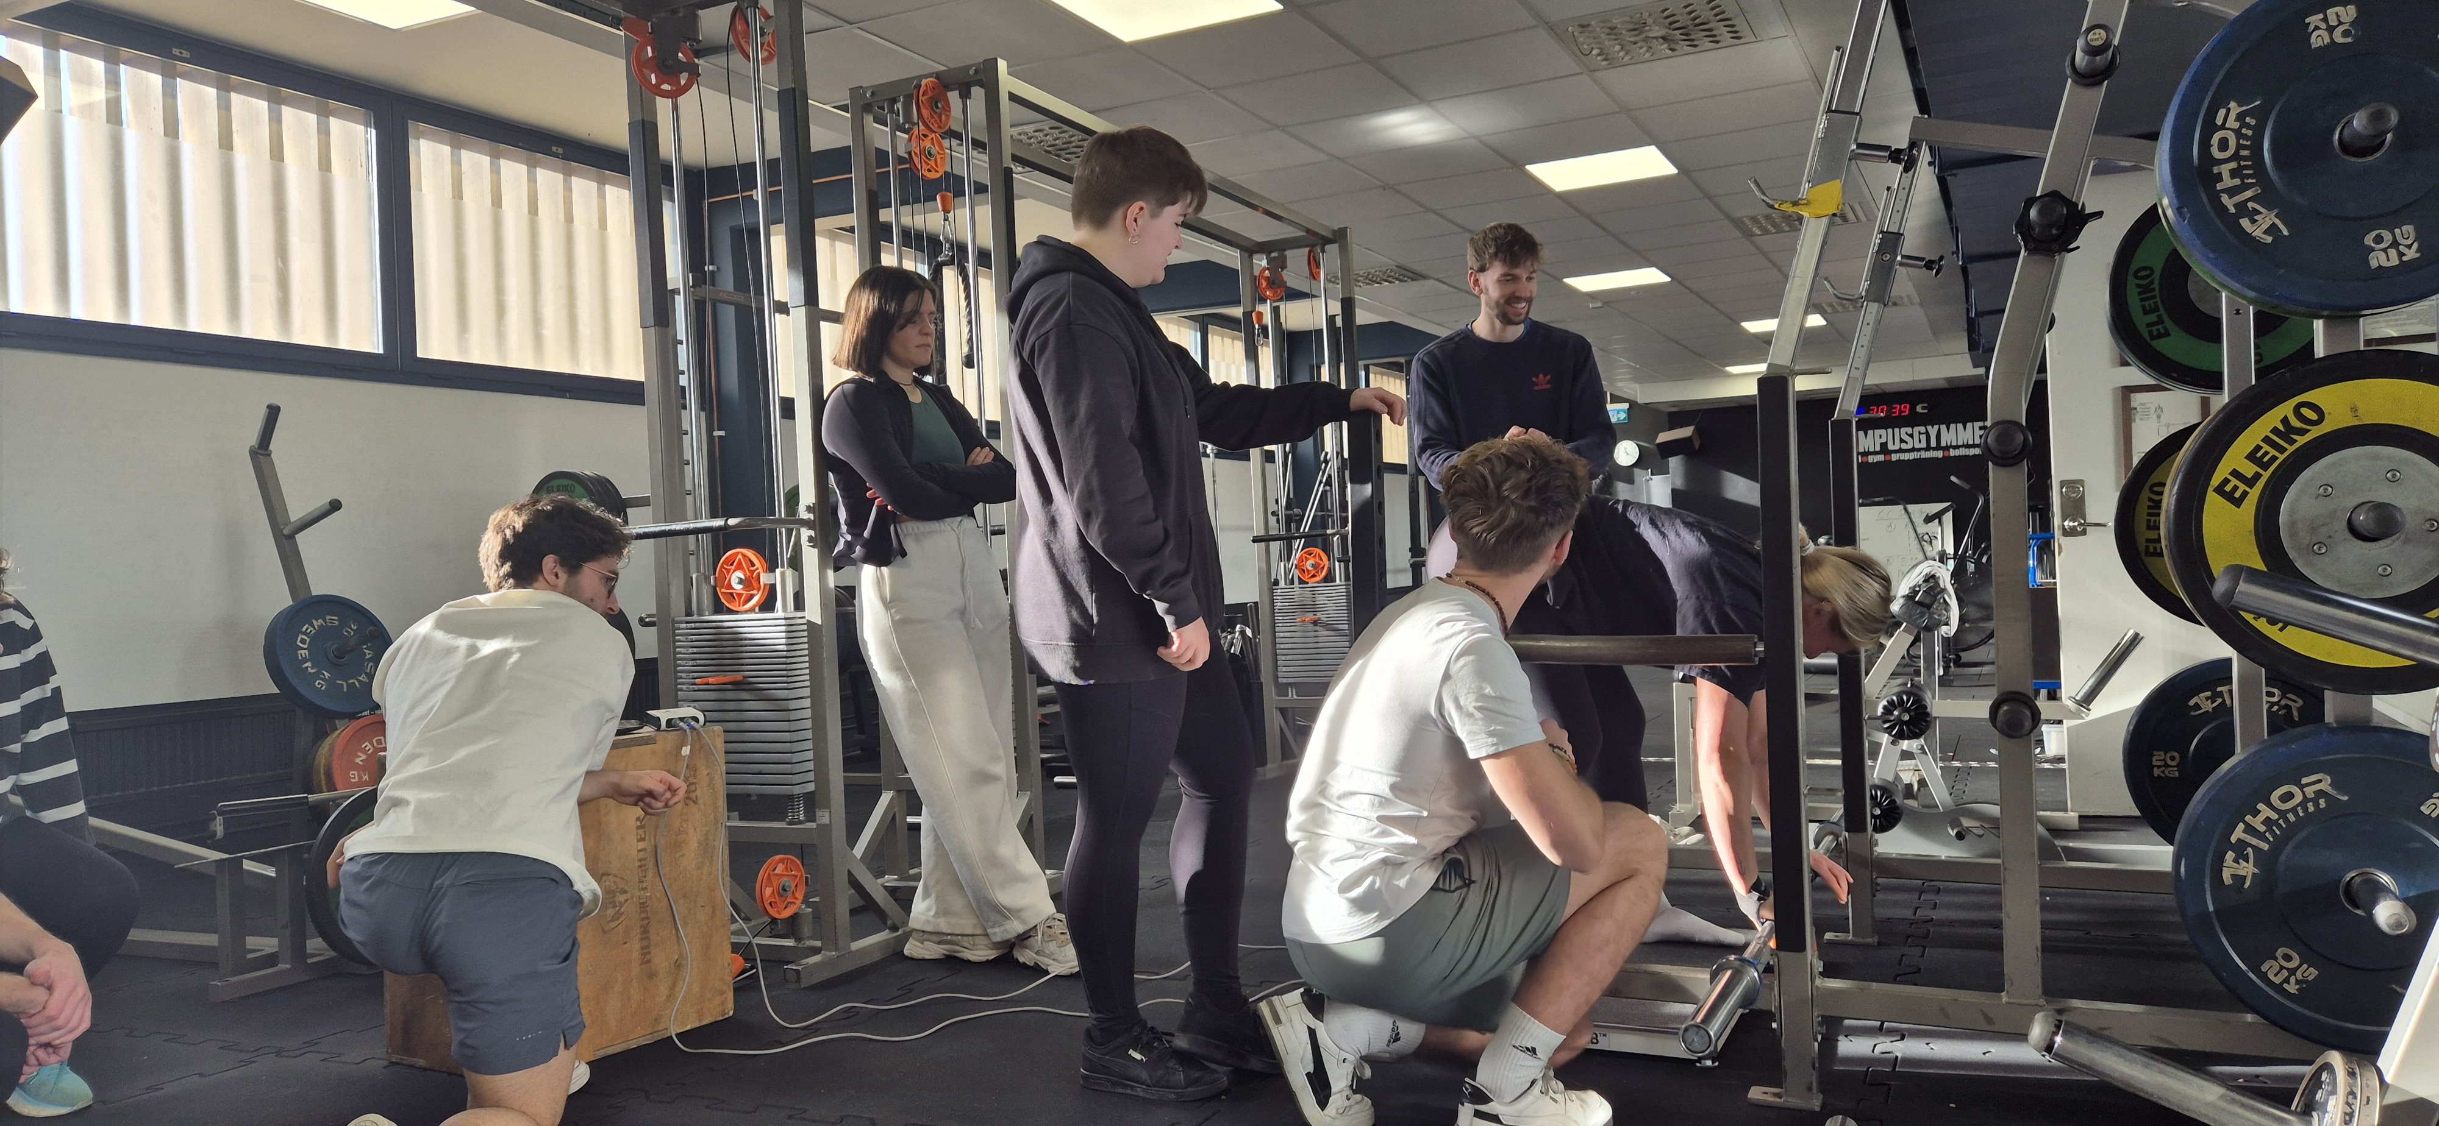
Contribution
Education
Integration from undergraduate to PhD level
  Dedicated course on testing and data visualisation
  VFU
  Thesis (Master and bachelor)
  Digital courses

Slide 13
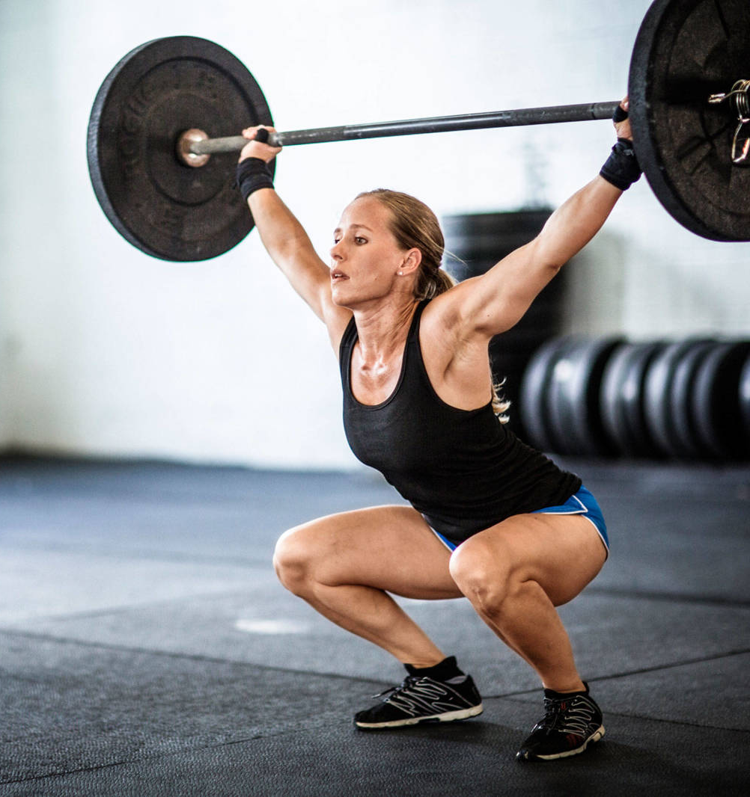
Contribution
Research
Training monitoring (team sport)
Recovery monitoring
Female physiology
Performance enhancement
This Photo by Unknown Author is licensed under CC BY-NC

