Slide 1

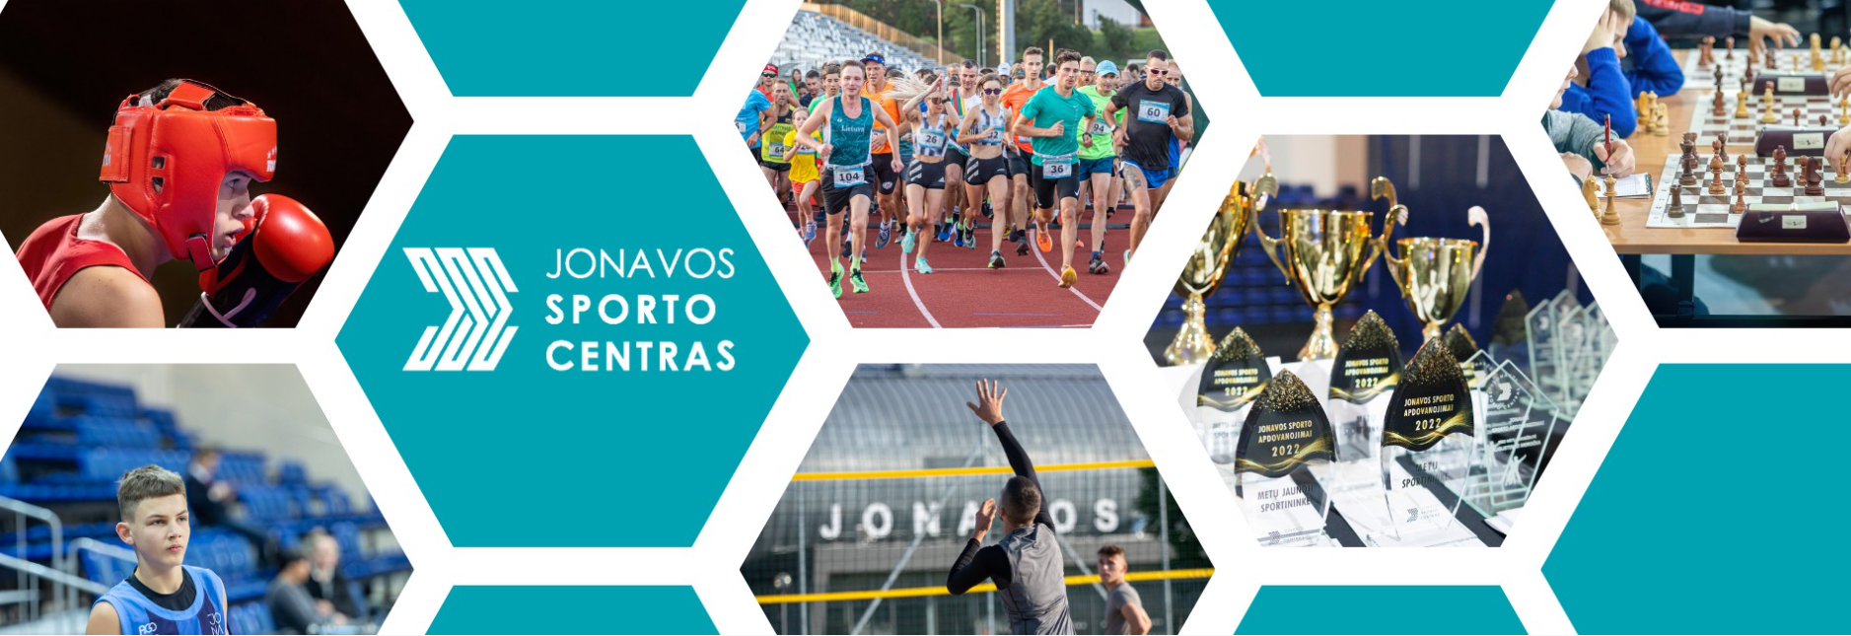


Jonava Sports Centre

Slide 2
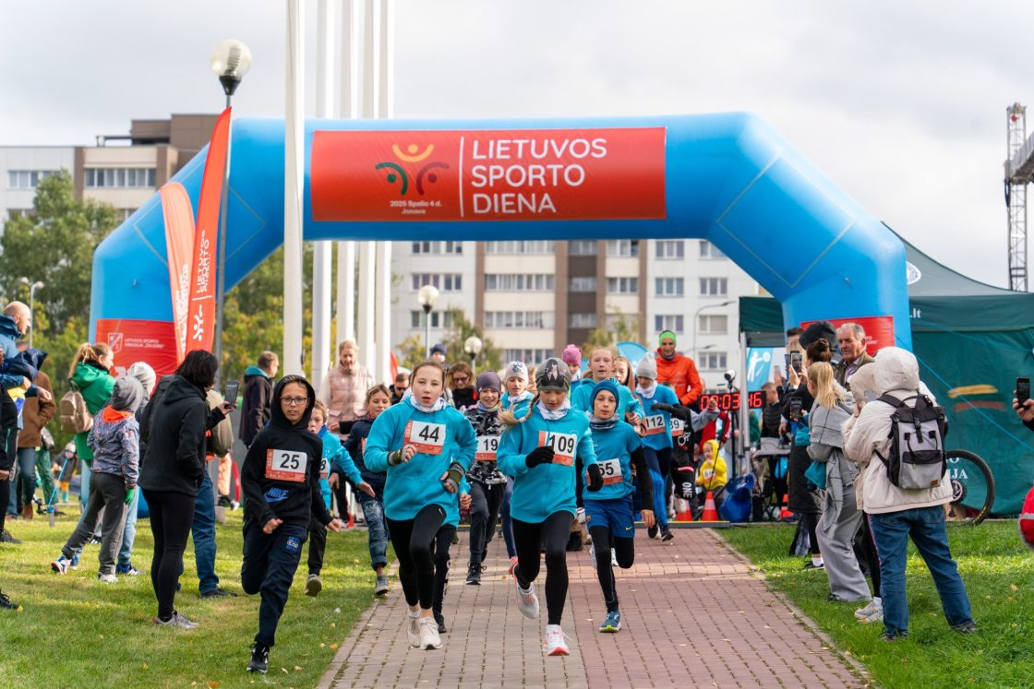
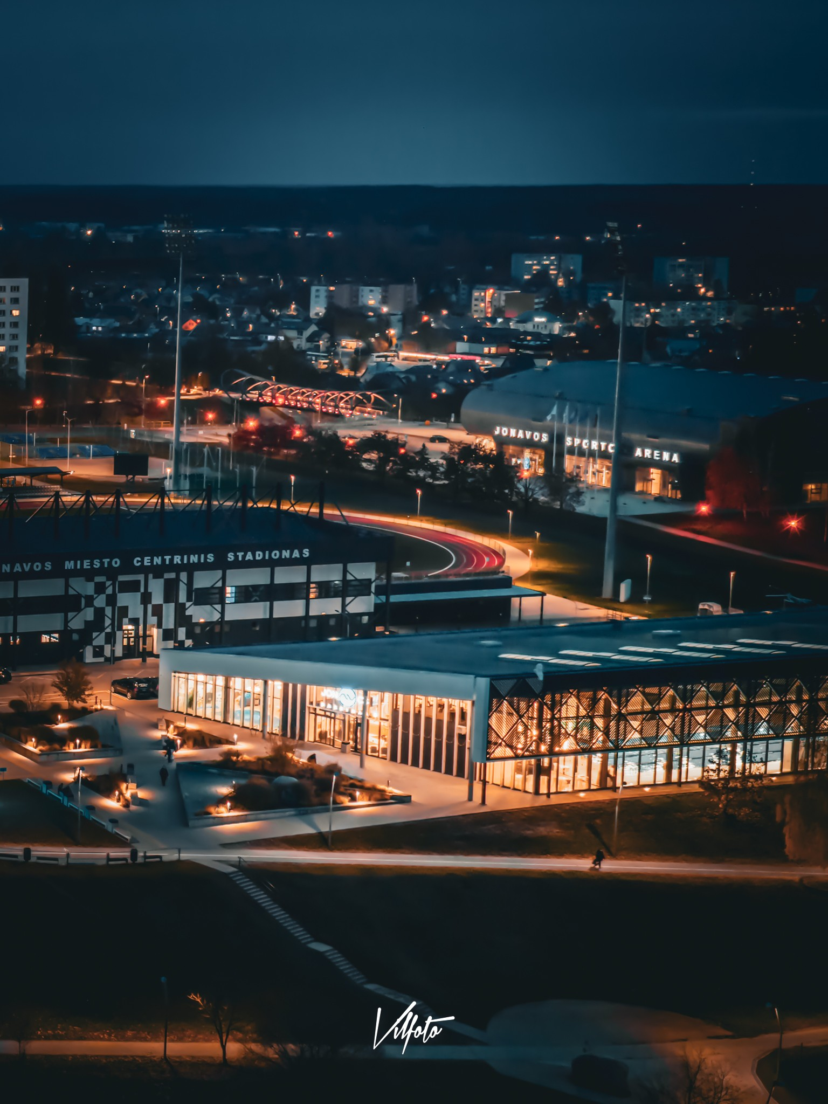
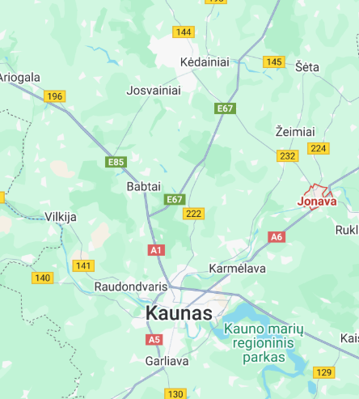
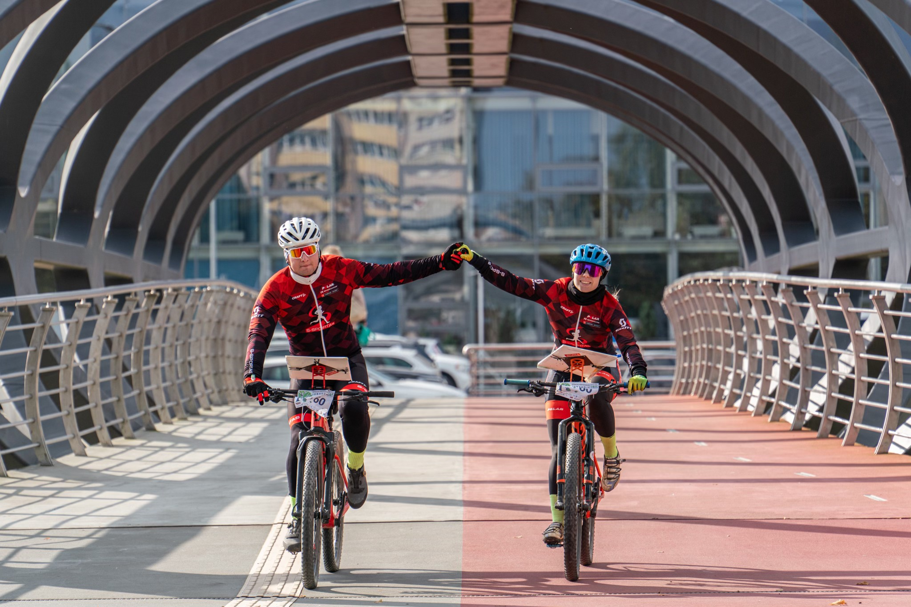

Slide 3

Institutional Profile
Jonava Sports Centre (JSC) is the municipal institution coordinating youth sports in the Jonava district. It oversees training programmes in seven kinds of sport (boxing, basketball, track and field, table tennis, volleyball, judo, and baseball) with over 550 young athletes participating.
550+
Athletes
20
As the main sports centre in the region, JSC employs qualified coaches who deliver structured physical and skill training.
The director and staff have advanced expertise in evidence-based coaching, emphasizing athlete development and well-being.
Coaches
7
Sport

Slide 4
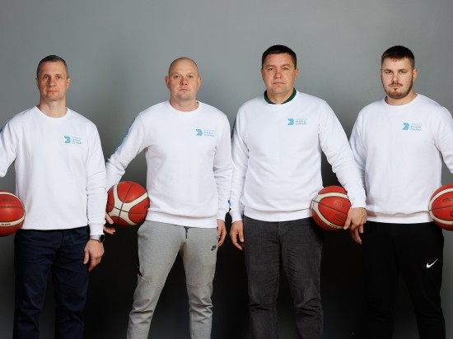
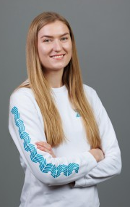
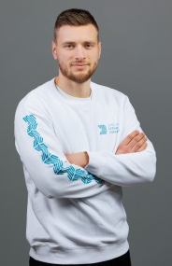
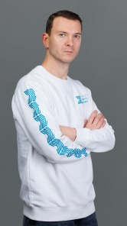
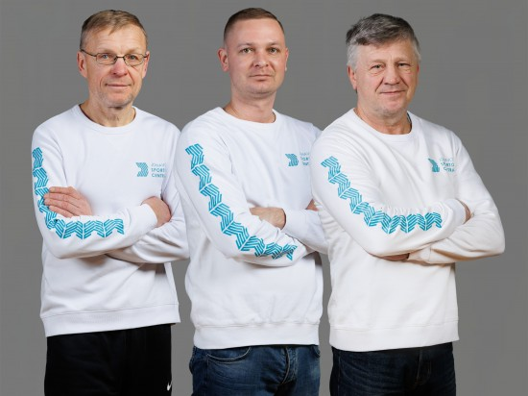
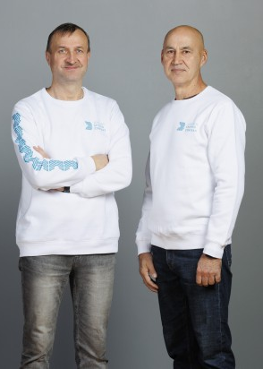
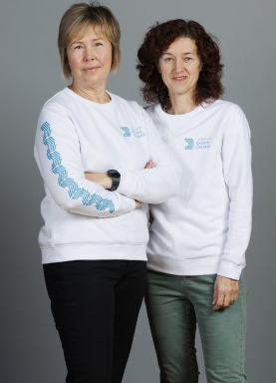
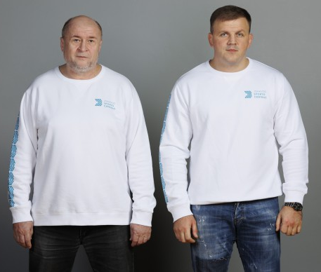
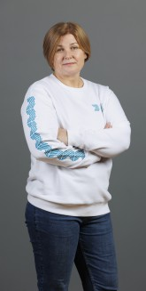
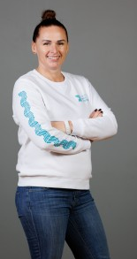
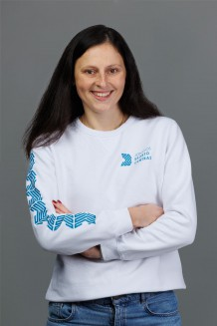

Coaches and staff
Technologijos integracija

Slide 5
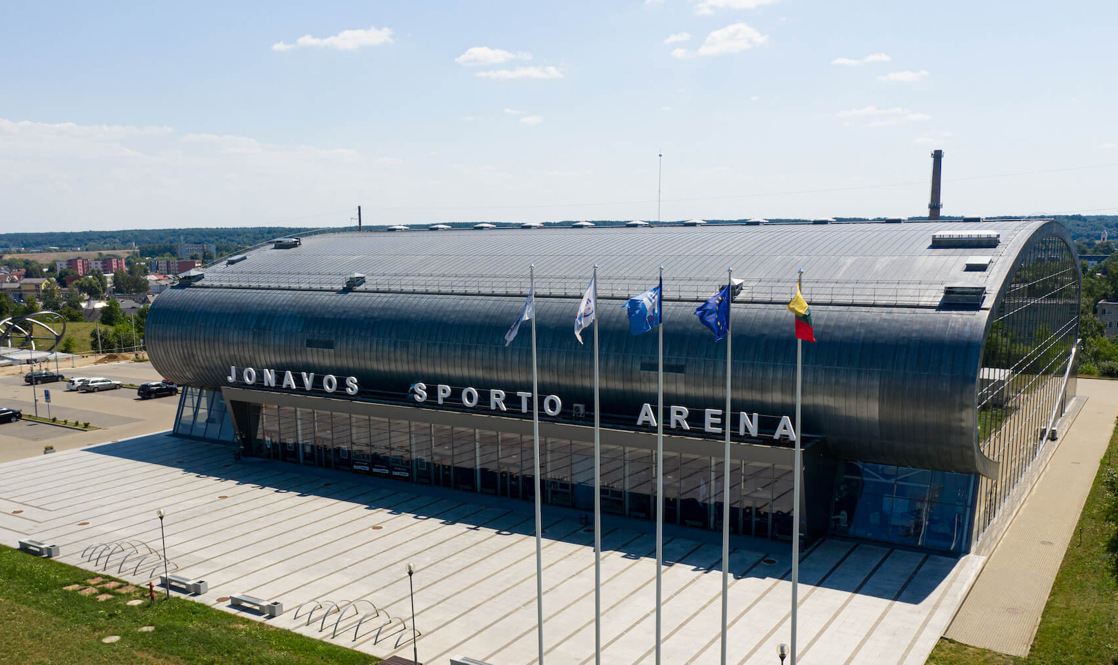
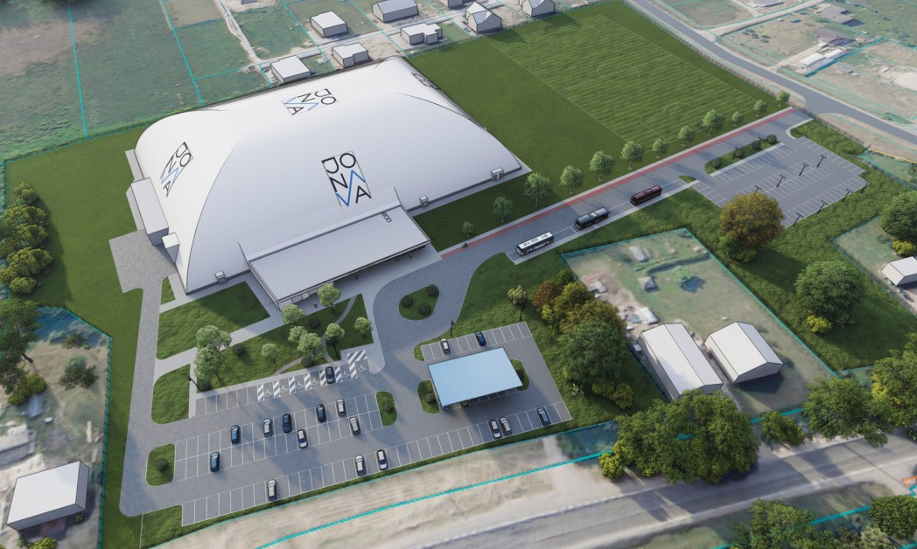
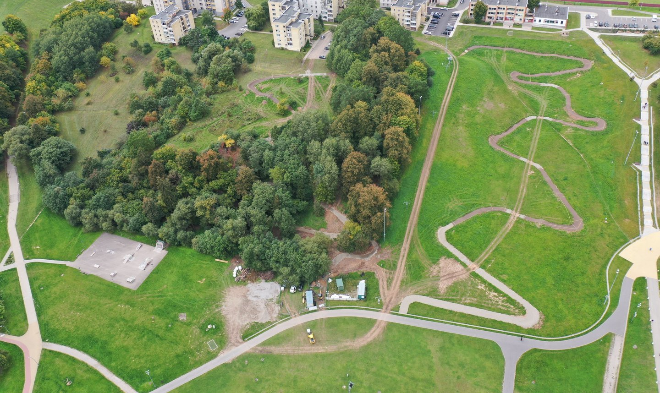
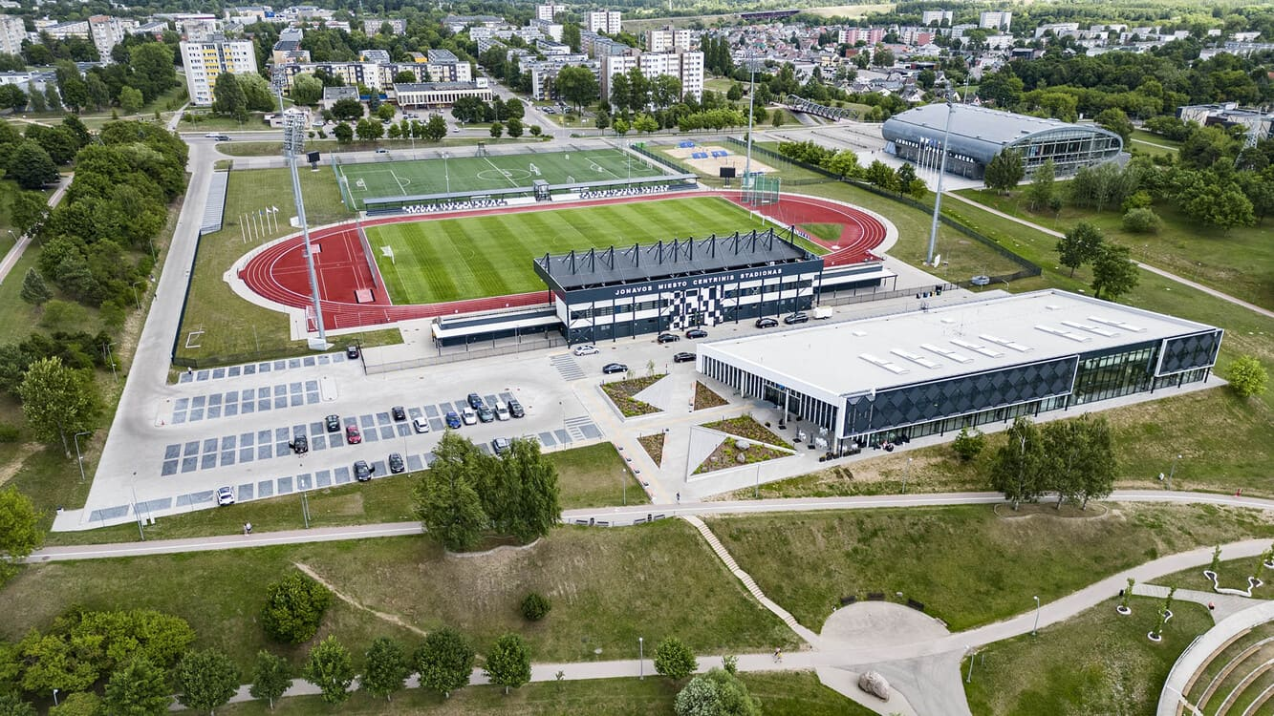
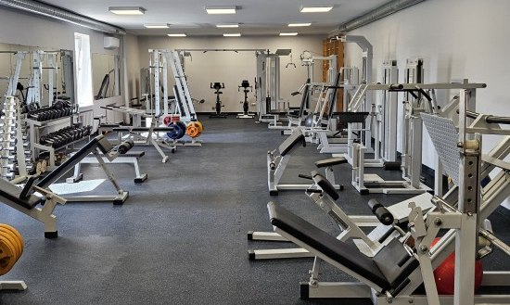
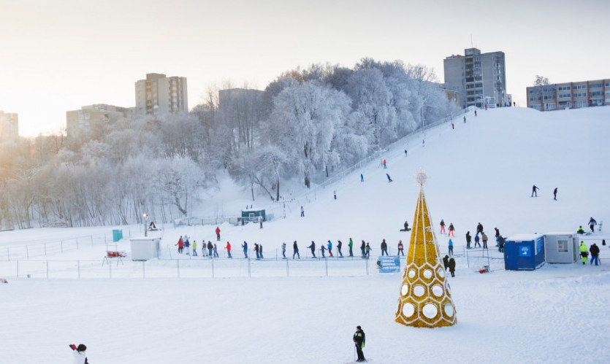
Infrastructure
Jonava Sports Center administers the following sports facilities: Arena, universal sports hall, city stadiums, ski and mountain bike trails, table tennis, boxing, judo halls and a gym. Currently, construction of a sports arena (manege) has begun, where football, baseball and track and field training will take place.
Technologijos integracija
Sportininkų įsitraukimas
Skaitmeninės priemonės padeda palaikyti motyvaciją ir stebėti progresą

Slide 6

International Project Involvement
The JSC leadership has extensive experience in European coaching and training projects. Key examples include:
1
2017–2019
Nordplus "Sustainable Approach Coaching Youth for Elite" – JSC’s director co-led this in this Nordic–Baltic network project (coordinated by LSU) focused on developing coach education programmes for talented young athletes. It built on previous Nordic coaching networks and emphasized holistic, research-based coach training for youth.
2
2018–2020
Erasmus+ "GAME" – JSC’s director co-led this Erasmus+ Sport project (“A Serious Game Approach in Mitigating Performance Enhancement Culture in Youth”) that used innovative serious-game pedagogy to educate youth about anti-doping. The project aimed to transform anti-doping education by using “state-of-art learning pedagogies” and gaming technology.
3
2019–2022
Nordplus NBUCE "Updated Coaching Experience" – JSC’s director was a Member of this consortium (project NPHZ 2019/10042) to update and harmonize coaching curricula across the Baltic–Nordic region. This network developed new study modules and practical courses for coaches, integrating modern sports science.
4
2022–2025
Nordplus Horizontal "Digitalization in the Coaching Process" – JSC’s director was a active member of this ongoing project (NPHZ 2022/10033) which examines how technology (apps, VR, exergames, etc.) can enhance coaching.

Slide 7
JSC provides useful tools to support
training monitoring
Varied group of athletes
Experienced Coaches and staff
Infrastructure and Facilities
Structured Testing Program
Our coaching staff includes specialists in each sport who are trained in contemporary methods (partly through the above projects). Two coaches have received intensive instruction in digital coaching methods via the Nordplus “Digitalization” project.
Over 550 youth athletes in 7 sports provide a large sample for testing and pilot studies. This diversity lets us test training strategies across genders, ages and sports
We operate modern training and testing facilities and infrastructures (gyms, tracks, courts, boxing rings, etc.) to conduct controlled assessments.
Twice a year, JSC runs standardized testing (general and sport-specific), ensuring consistent monitoring of workload and development. Although not formally documented in external sources, this practice is integral to our training process.

Slide 8





Contribution to the Project
In the Mastering the Sport Coaching Process project, Jonava Sports Centre offers:
Practical Expertise
With a proven track record in coaching education (through Erasmus+ and Nordplus projects), we bring pedagogical experience in training monitoring to share.
Research & Innovation
Our systematic testing program and tech-savvy coaches (trained in digital tools) make us an ideal partner for trials of new monitoring methods or curricula.
Human Resources
We can host workshops or pilot training modules on load management
Regional Outreach
As the district’s sports hub, JSC can disseminate project findings to schools, clubs and local sports federations, amplifying educational impact
Together, JSC’s resources and expertise – from advanced coach training projects to rigorous athlete testing – position us to contribute substantially to research and educational activities on training load monitoring and coach competence

