Slide 1
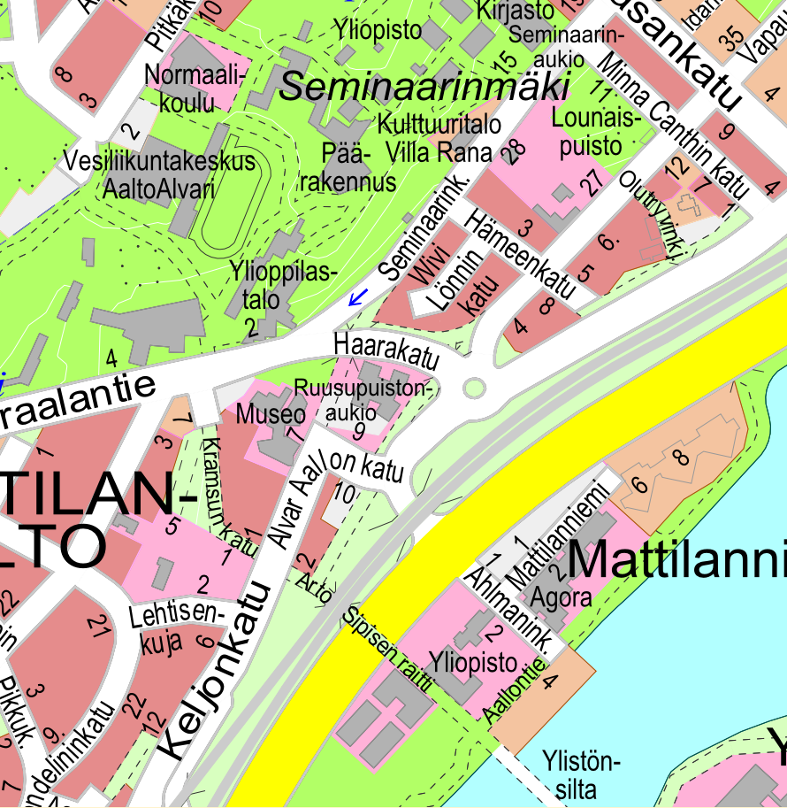


Lyhty
Liikunta
Walking route from
Alba hotel to Lyhty
Alba hotel

Slide 2
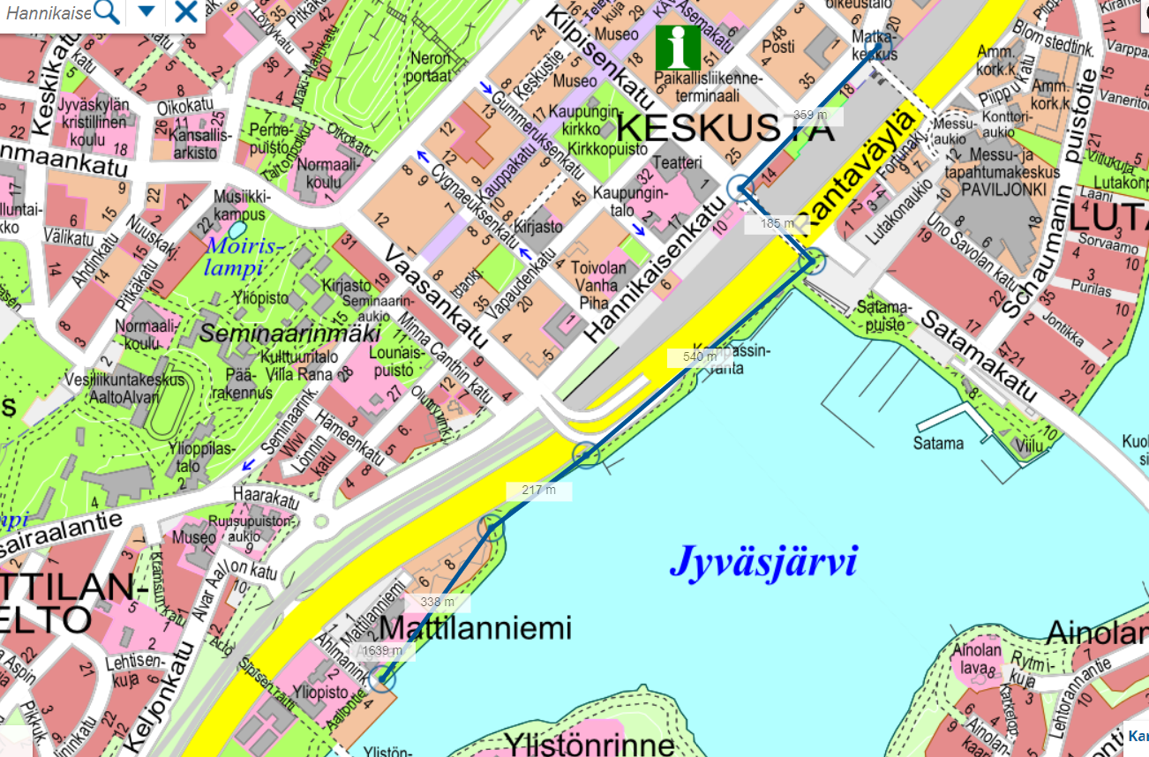
Walking route from railway station to Alba hotel, marked in blue (1,6 km)
Railway station
Alba hotel

