Slide 1
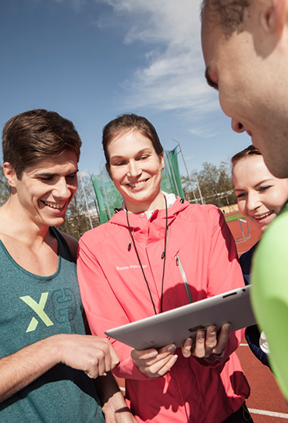

Programme
for the Nordplus meeting 4.5.2020

Slide 2
1. Orientation, 10 min
2. Pedagogical solutions that support learning objectives and online learning
- ABC planning tool, 20 min
3. Working in three groups: 60 min (10min break included)
a) philosophy & coach athlete relationships
b) growth and maturity and musculoskeletal injuries in young athletes
c) strength and conditioning

Slide 3
4. ABC teaching planning tool summary of plans, 15 min (what did you learn from the ABC tool?).
5. Summing up the meeting and plans for future:
- Clarify the the course’s objectives
and structure overall 15 min discussion

