Slide 1

Techical Check in!
Check and update Your name -> (Participants->rename)
In your greeting, tell us what kind of book you could write about your corona time?
When your voice is heard, you can at least mute the microphone.
Hold your microphone (mute) when you're not talking.
Are you 100% present?☺
Bring virtual patience!
Relax for a moment, we start at 10:00
We will record the main session!

Slide 2
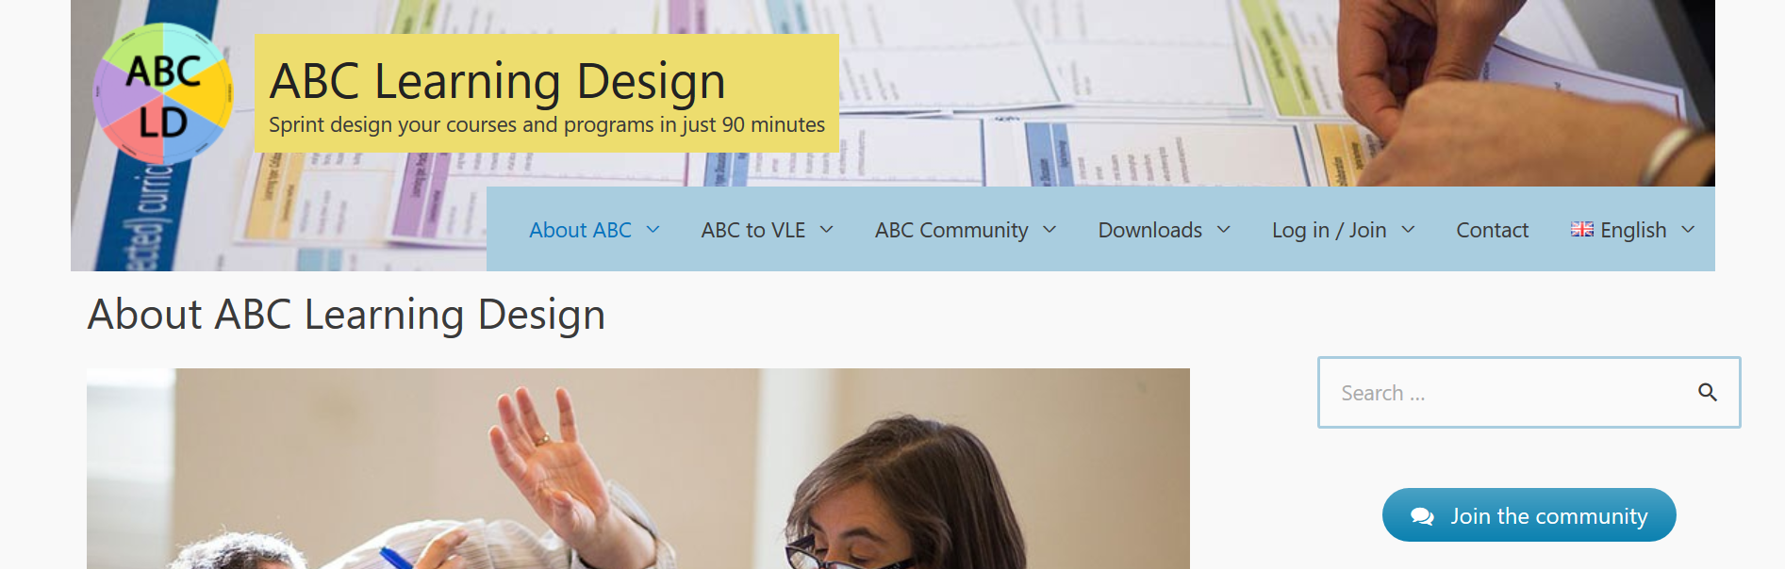
What is online learning?
7 (6+1)Learning ways
ABC-model: Contact teaching to online teaching
Toolkit english
https://abc-ld.org/

Slide 3



7 types of learning: Objectives
We will get know 7 types of learning (6+1)
We will get some new ideas:
  How can contact teaching be supplemented, enriched and made more flexible by utilizing the tasks and elements of e-learning?
  We learn to consider and reflect the benefits and challenges of e-learning activities.

Slide 4
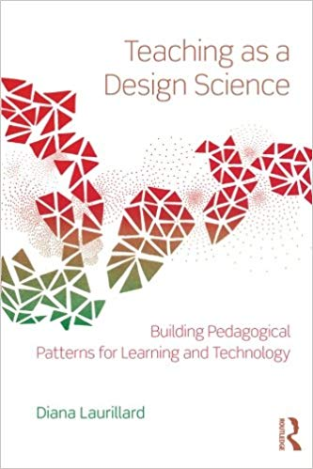
ABC Learning Design
The ABC curriculum design method is an effective and engaging hands-on, card-based approach to curriculum design – curriculum design is where change happens.
Why ABC?
fast – requires minimal preparation
student centred approach
stimulates informed dialogue among teams
aligns to strategic aims
encourages blended approaches
based on established theory ‘Conversational Framework’ (Laurillard 2012)
discipline-neutral
widely used - growing international community

Slide 5
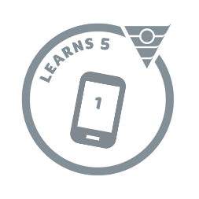

B is for Blended= Blended learning
a combination of face-to-face and online teaching
a combination of technologies
a combination of methodologies
Sharma (2010)

Slide 6
Interactivity & collaboration in e-learning
Increasing the time spent on e-learning is only useful when the learning is interactive.(Castaño-Muñoz et al., 2014)
In order to meaningfully increase learning in the online community, social interaction itself is not yet enough, but the interaction must be guided and linked to pedagogy. (Garrison & Arbaugh, 2007)
A meaningful combination of independent study and learning together often produces the best learning outcomes. Pedagogy as collaborative design science (Laurillard, 2012).

Slide 7
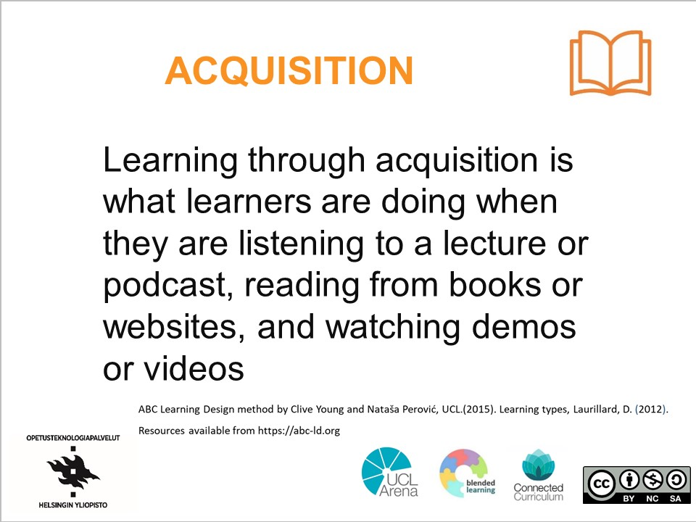
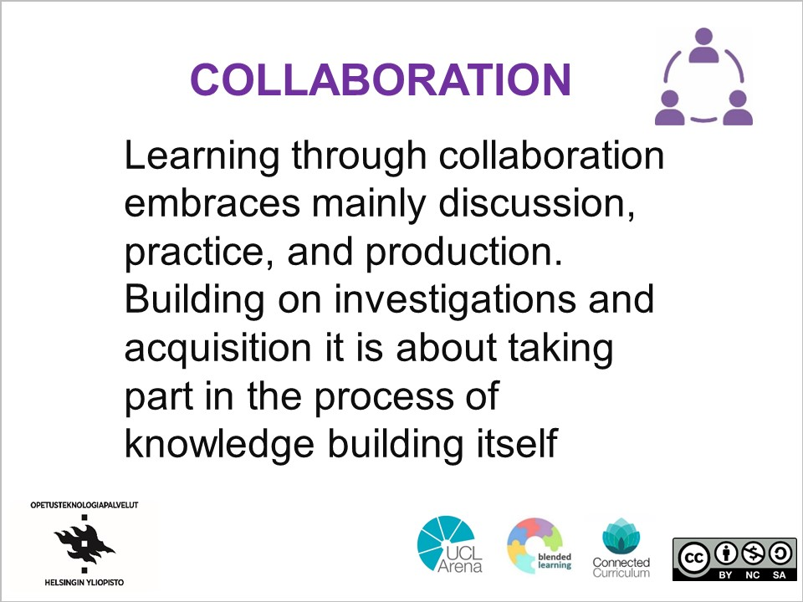
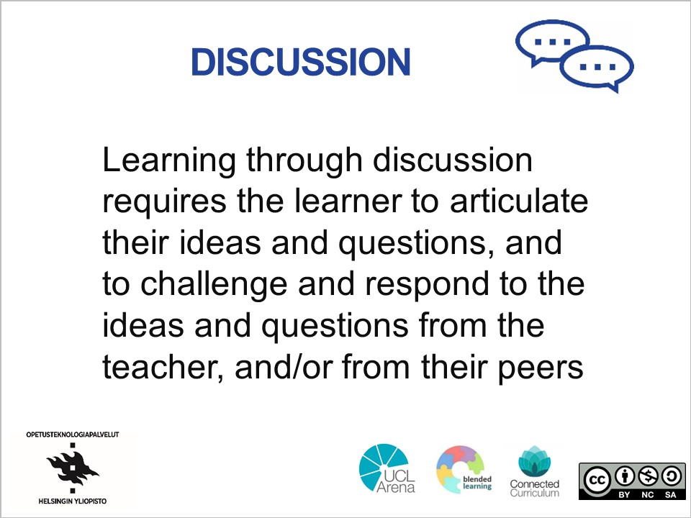
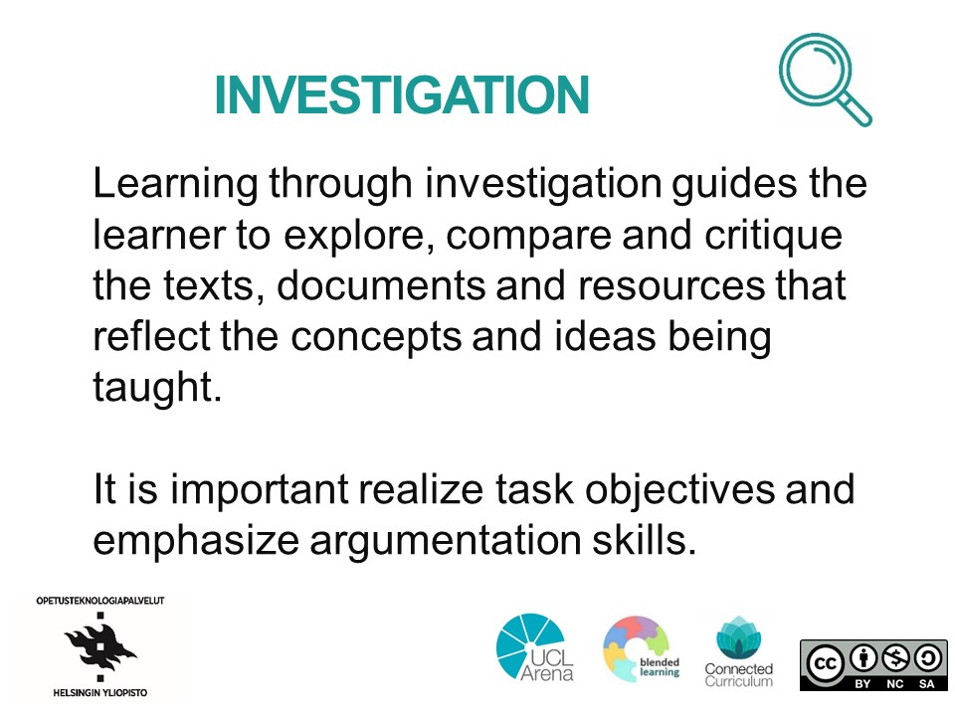
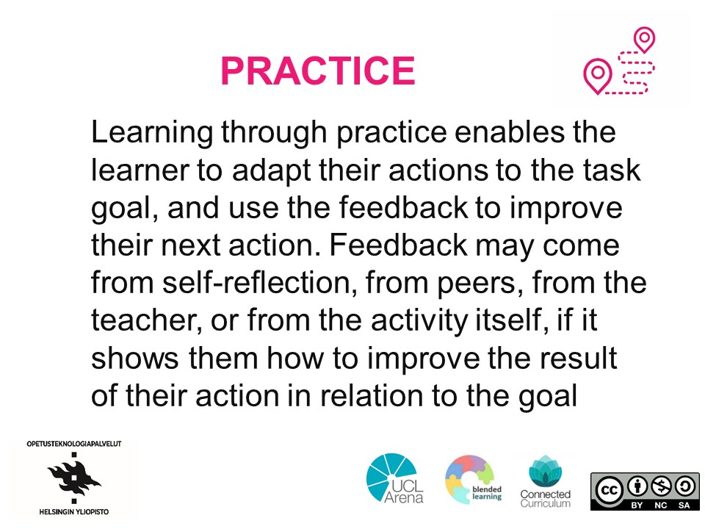
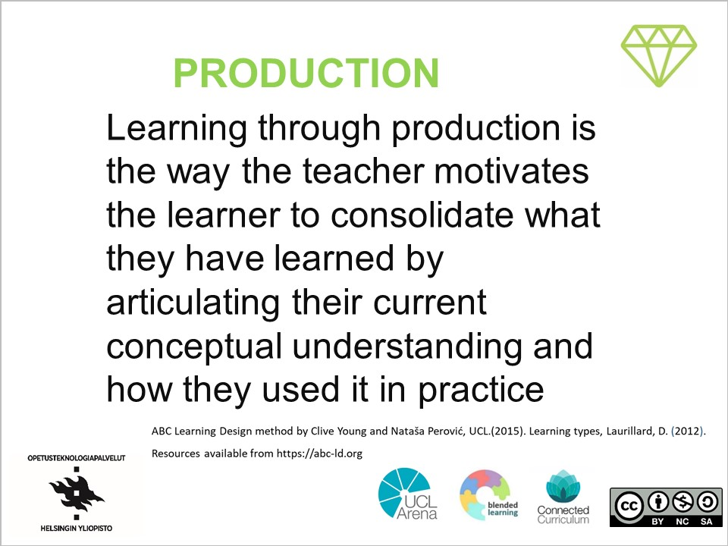
Learning types cards (front)
learning types on one side and examples of activities on the other

Slide 8
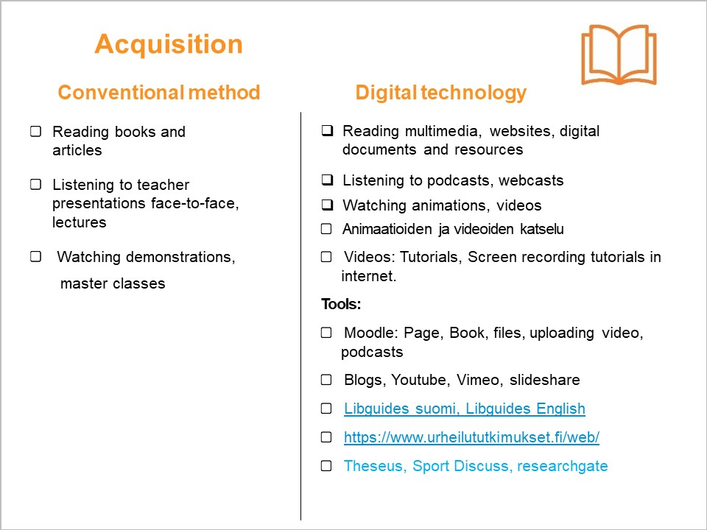
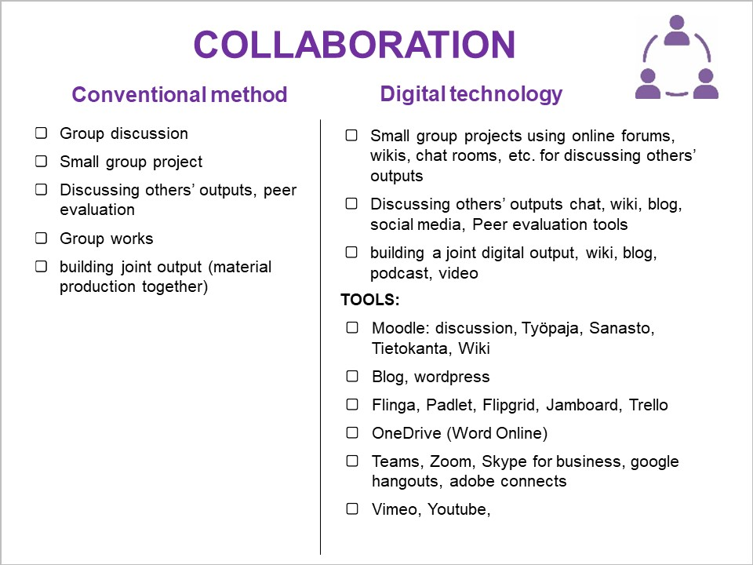
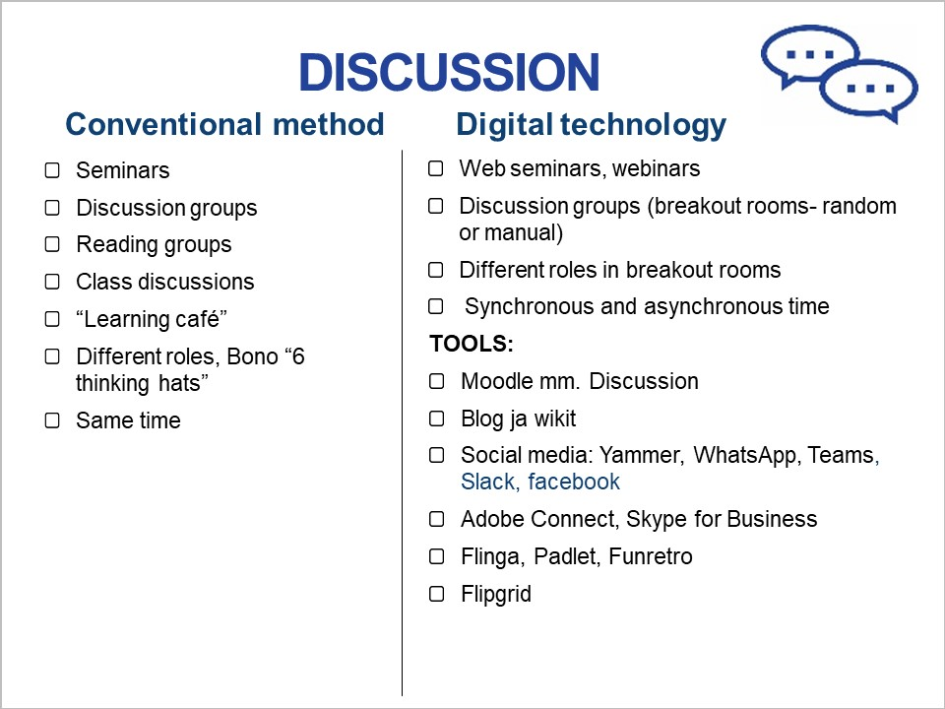
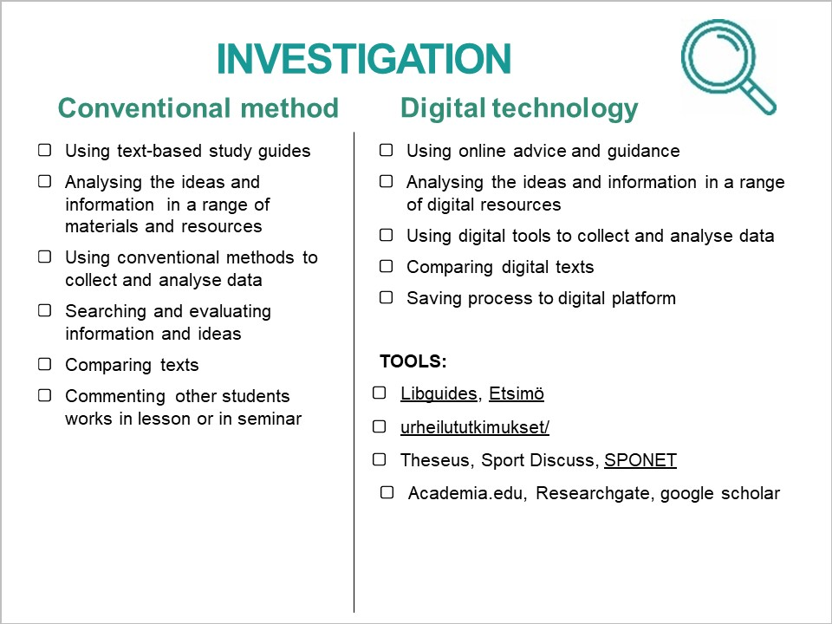
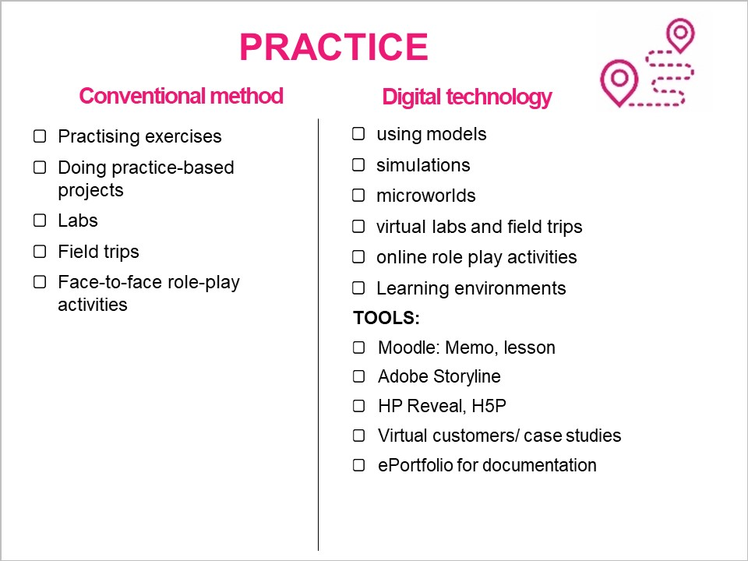
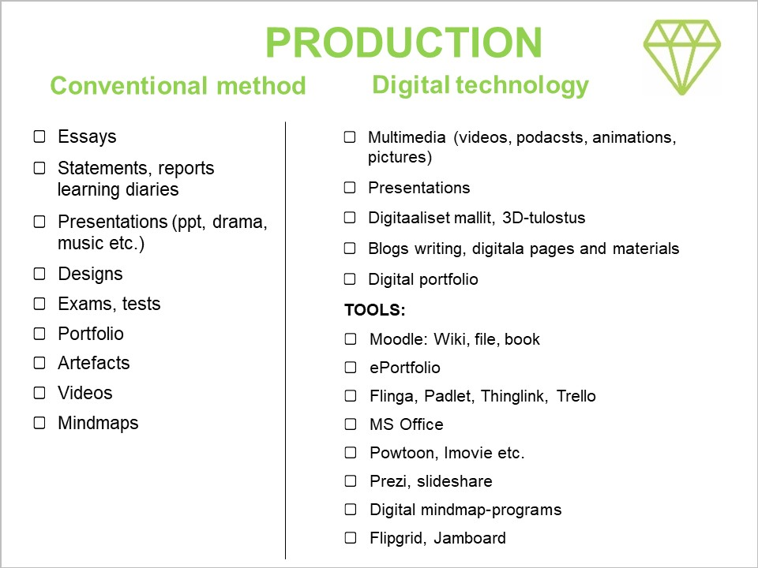
Learning types cards (back)
learning types on one side and examples of activities on the other

Slide 9







ATMOSPHERE & ORIENTATION
The student tunes in to peers, focuses on studies and learning environment. Student recognizes the role of the group in learning and commits to its activities as agreed.

Slide 10


ATMOSPHERE & ORIENTATION
Conventional method
Digital technology
Study plans/syllabus
Learning objectives
Process charts with guidelines
Teachers introduction
Students introduction
Group cohesion exercises
Group agreements
Study plans/syllabus, Learning objectives
Pages study guides Q&A
Welcome videos and podcasts
Presentations ,Ice Breakers
Profiling students knowledge and ability
Small Groups, Group agreements
Tools:
Digital platforms: Moodle, Prima, google classroom
Flipgrid
Zoom: annotate, polls
Padlet, Flinga, Funretro, Jamboard
Mentimeter, Kahoot, Quizizz
Adobe & Google tools

Slide 11

ACQUISITION
Learning through acquisition is what learners are doing when they are listening to a lecture or podcast, reading from books or websites, and watching demos or videos

Slide 12

Acquisition
Conventional method
Digital technology
Reading books and articles
Listening to teacher presentations face-to-face, lectures
Watching demonstrations,
master classes
Reading multimedia, websites, digital documents and resources
Listening to podcasts, webcasts
Watching animations, videos
Animaatioiden ja videoiden katselu
Videos: Tutorials, Screen recording tutorials in internet.
Tools:
Moodle: Page, Book, files, uploading video, podcasts
Blogs, Youtube, Vimeo, slideshare
Libguides suomi, Libguides English
https://www.urheilututkimukset.fi/web/
Theseus, Sport Discuss, researchgate

Slide 13

PRODUCTION
Learning through production is the way the teacher motivates the learner to consolidate what they have learned by articulating their current conceptual understanding and how they used it in practice

Slide 14

PRODUCTION
Conventional method
Digital technology
Essays
Statements, reports learning diaries
Presentations (ppt, drama, music etc.)
Designs
Exams, tests
Portfolio
Artefacts
Videos
Mindmaps
Multimedia (videos, podacsts, animations, pictures)
Presentations
Digital models, 3D-print
Blogs writing, digital pages and materials
Digital portfolio
TOOLS:
Moodle: Wiki, file, book
ePortfolio
Flinga, Padlet, Thinglink, Trello
MS Office
Powtoon, Imovie etc.
Prezi, slideshare
Digital mindmap-programs
Flipgrid, Jamboard

Slide 15

COLLABORATION
Learning through collaboration embraces mainly discussion, practice, and production. Building on investigations and acquisition it is about taking part in the process of knowledge building itself
Notes:
Yhteistoiminnallinen oppiminen
Yhdessä oppimista ja tiedon rakentamista, mm. keskusteluja, harjoittelua ja materiaalien tuottamista.
Tukee tiedon omaksumista ja tutkimista konstruoiden eli yhdessä tietoa rakentaen.

Slide 16

COLLABORATION
Conventional method
Digital technology
Group discussion
Small group project
Discussing others’ outputs, peer evaluation
Group works
building joint output (material production together)
Small group projects using online forums, wikis, chat rooms, etc. for discussing others’ outputs
Discussing others’ outputs chat, wiki, blog, social media, Peer evaluation tools
building a joint digital output, wiki, blog, podcast, video
TOOLS:
Moodle: discussion, workshop, wocabulary, files, Wiki
Blog, wordpress
Flinga, Padlet, Flipgrid, Jamboard, Trello
OneDrive (Word Online)
Teams, Zoom, Skype for business, google hangouts, adobe connects
Vimeo, Youtube,

Slide 17

DISCUSSION
Learning through discussion requires the learner to articulate their ideas and questions, and to challenge and respond to the ideas and questions from the teacher, and/or from their peers
Notes:
Opiskelija oppii:
Selkeästi muodostamaan ja esittelemään omat ideansa ja kysymyksensä.
Vastaamaan opettajan ja muiden opiskelijoiden esittämiin kysymyksiin ja haastamaan heidän esittämiä ajatuksia.
Keskustelut liittyvät luontaisesti käsitykseen tiedon yhteistoiminnallisesta rakentamisesta.

Slide 18

DISCUSSION
Conventional method
Digital technology
Seminars
Discussion groups
Reading groups
Class discussions
“Learning café”
Different roles, Bono “6 thinking hats”
Same time
Web seminars, webinars
Discussion groups (breakout rooms- random or manual)
Different roles in breakout rooms
Synchronous and asynchronous time
TOOLS:
Moodle mm. Discussion
Blog ja wikit
Social media: Yammer, WhatsApp, Teams, Slack, facebook
Adobe Connect, Skype for Business
Flinga, Padlet, Funretro
Flipgrid
Notes:
Seminaarit
Keskusteluryhmät
Lukupiirit
Vuorovaikutteiset luennot
Yhteistoiminnallinen palapeli (“Jigsaw”)-aktiviteetti
“Learning café”
Roolien jako keskustelussa (kts. esim. de Bonon “6 thinking hats”)
Samanaikaisuus

Slide 19

INVESTIGATION
Learning through investigation guides the learner to explore, compare and critique the texts, documents and resources that reflect the concepts and ideas being taught.
It is important realize task objectives and emphasize argumentation skills.
Notes:
Tutkiva oppiminen ohjaa opiskelijoita etsimään ja vertailemaan tietoa sekä esittämään kritiikkiä ja soveltamaan tekstejä, dokumentteja ja muita materiaaleja, jotka liittyvät opetettavan aiheen ja kurssin sisältöihin ja käsitteisiin.
Tutkiva oppiminen painottaa argumentaatiotaitoja ja tehtävän tavoitteiden ymmärtämistä.

Slide 20

INVESTIGATION
Conventional method
Digital technology
Using text-based study guides
Analysing the ideas and information in a range of materials and resources
Using conventional methods to collect and analyse data
Searching and evaluating information and ideas
Comparing texts
Commenting other students works in lesson or in seminar
Using online advice and guidance
Analysing the ideas and information in a range of digital resources
Using digital tools to collect and analyse data
Comparing digital texts
Saving process to digital platform
TOOLS:
Libguides, Etsimö
urheilututkimukset/
Theseus, Sport Discuss, SPONET
Academia.edu, Researchgate, google scholar
Notes:
Verkosta löytyvät ohjeet ja neuvot
Monimedialukutaito, lähdekriittisyys
Ideoiden ja tiedon haku, analysointi ja soveltaminen erilaisista digitaalisista lähteistä
Tiedonhaku ja analysointi digitaalisten työvälineiden avulla
Prosessin tallentaminen esim. verkkoalustalle tai jaettuun kansioon
Digitaalisten tekstien vertailu
Digitaalisten työvälineiden hyödyntäminen tiedon ja ideoiden hakuun ja arviointiin:
VÄLINEET ESIMERKIKSI:
Libguides, Etsimö
urheilututkimukset/
Theseus, Sport Discuss, SCI-HUB, SPONET
Academia.edu, Researchgate, google scholar

Slide 21

PRACTICE
Learning through practice enables the learner to adapt their actions to the task goal, and use the feedback to improve their next action. Feedback may come from self-reflection, from peers, from the teacher, or from the activity itself, if it shows them how to improve the result of their action in relation to the goal
Notes:
Tyypillisesti harjoitteluun kuuluu autenttisia tehtäviä, kontekstisidonnaista oppimista sekä oppimista kokemuksen kautta. Erityisesti työelämän autenttiset tehtävät, kuten työharjoittelu, kenttätyö, laboratoriotyö, posterin kirjoittaminen, jne. sopivat harjoittelutehtäviksi.
Palautteen ja reflektoinnin merkitys on tärkeä oppimisprosessissa. Huomaa, että palaute voi olla sisäistä tai ulkoista.

Slide 22

PRACTICE
Conventional method
Digital technology
Practising exercises
Doing practice-based projects
Labs
Field trips
Face-to-face role-play activities
using models
simulations
microworlds
virtual labs and field trips
online role play activities
Learning environments
TOOLS:
Moodle: Memo, lesson
Adobe Storyline
HP Reveal, H5P
Virtual customers/ case studies
ePortfolio for documentation
Notes:
Käytännön töiden harjoittelu
Laboratoriotyöskentely
Kenttäretket
Akateemisten taitojen harjoittelu
Työharjoittelu
Toimeksiannot
Työelämäyhteistyö

Slide 23
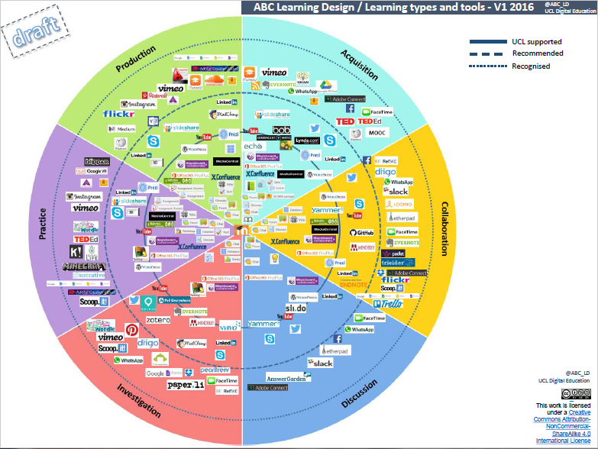
https://abc-ld.org/

Slide 24



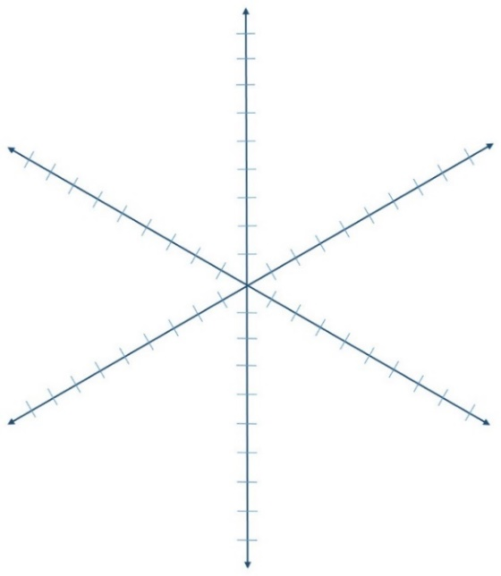





ABC LEARNING DESIGN WORKSHOP
ACQUISITION
PRACTICE
COLLABORATION
Module summary (tweet size description of your module):
PRODUCTION
DISCUSSION
INVESTIGATION
Learning types activities graph
How do you envisage your module will look on the graph above? (in red - at the beginning of the workshop)
Your module activity graph at the end of the workshop (in blue)
online
x
face to face
Sulautuvan opetuksen/oppimisen jatkumo
Where do you want to be on the scale (in red)
What is your position at the end of the workshop (in blue)
Finnish translation and adaptation by the Educational Technology Services of the University of Helsinki, 2018; based on the ABC curriculum design workshop and resources by Clive Young & Natasa Perovic, Digital Education, UCL, 2015. Licensed under Creative Commons CC BY-NC-SA 4.0 (Attribution-NonCommercial-ShareAlike) https://creativecommons.org/licenses/by-nc-sa/4.0/
d

Slide 25
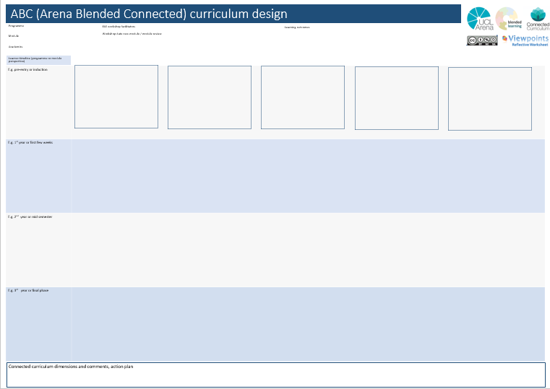

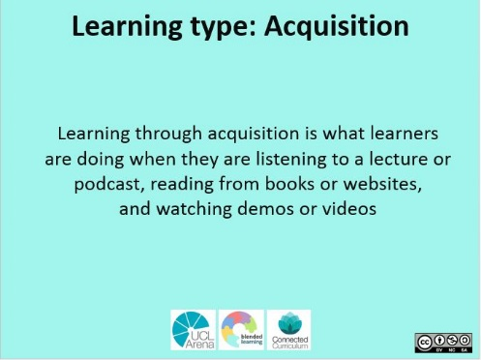
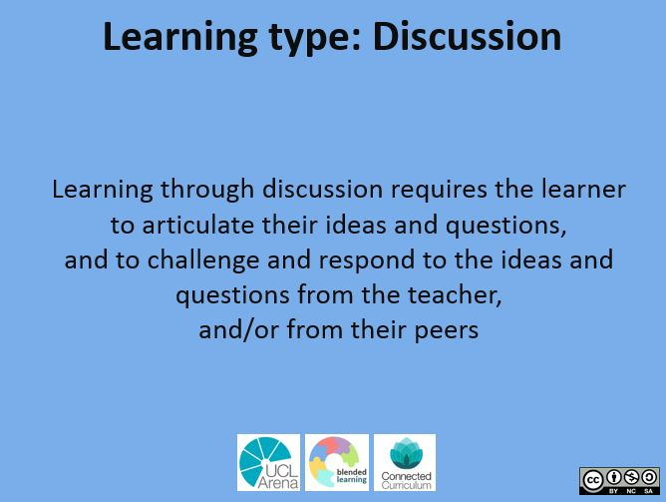
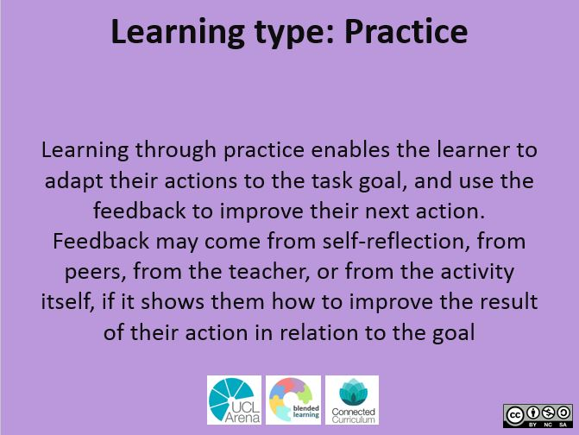
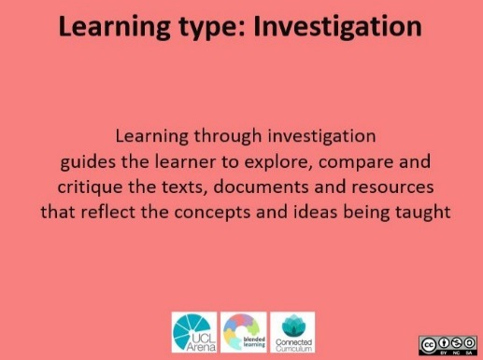
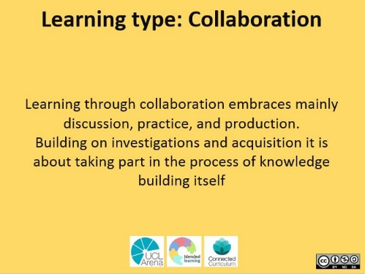
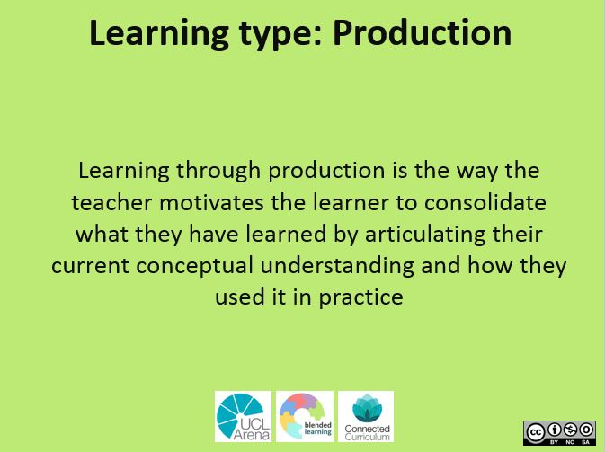
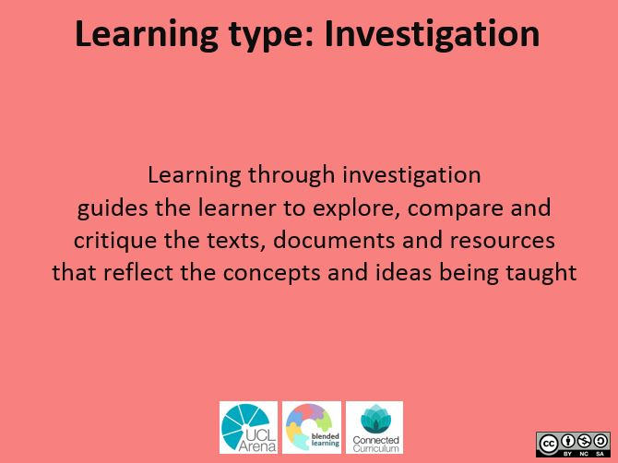
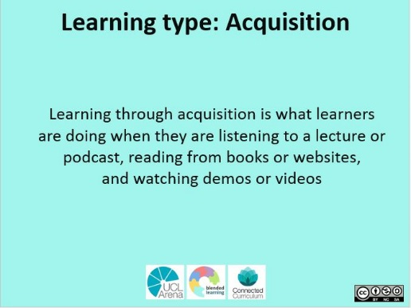

ABC Learning Design
Your module may look like this
Week
1-4
Week
5-8
project
reflection

Slide 26
ABC Learning Design
Your module may look like this
Week
1-4
Then when you are happy then you can turn the cards over and choose your learning activities..
Week
5-8
project
reflection

Slide 27
Break out room workshop ABC 60min
From the group, choose a person who will take notes as well as a raport for your output. The writer records questions and thoughts that arise during the workshop to flinga wall. “The rapporteur” prepares to present the main points of your output at the end of the workshop (approx. 5 min)
Check out fast objectives from your topics
Check out cards and meaning of cards
Make a course description by discussing the theme of the course you have chosen.
  Take advantage of the cards and make a description for the design template.
  By discussing, choose the appropriate learning methods for the course and add them to the plan template..
Plan what learning styles are involved in the course and add them to the poster. Then turn the cards over and think about the activities presented. Also consider whether you choose contact or online teaching.

Slide 28
Groups
Philosophy and psychology (Markus, Pekka)
Human growth and sport injury (Kimmo)
Physical conditioning (Mika)
Links:
https://edu.flinga.fi/s/E6Y96JR
https://edu.flinga.fi/s/EEMD276
https://edu.flinga.fi/s/EEDEBM9

Slide 29
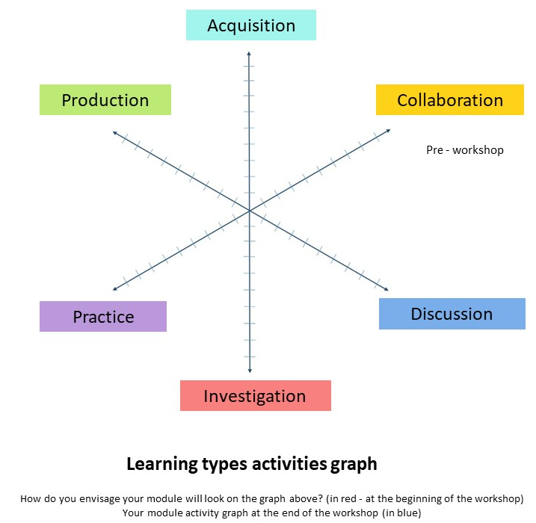

Slide 30
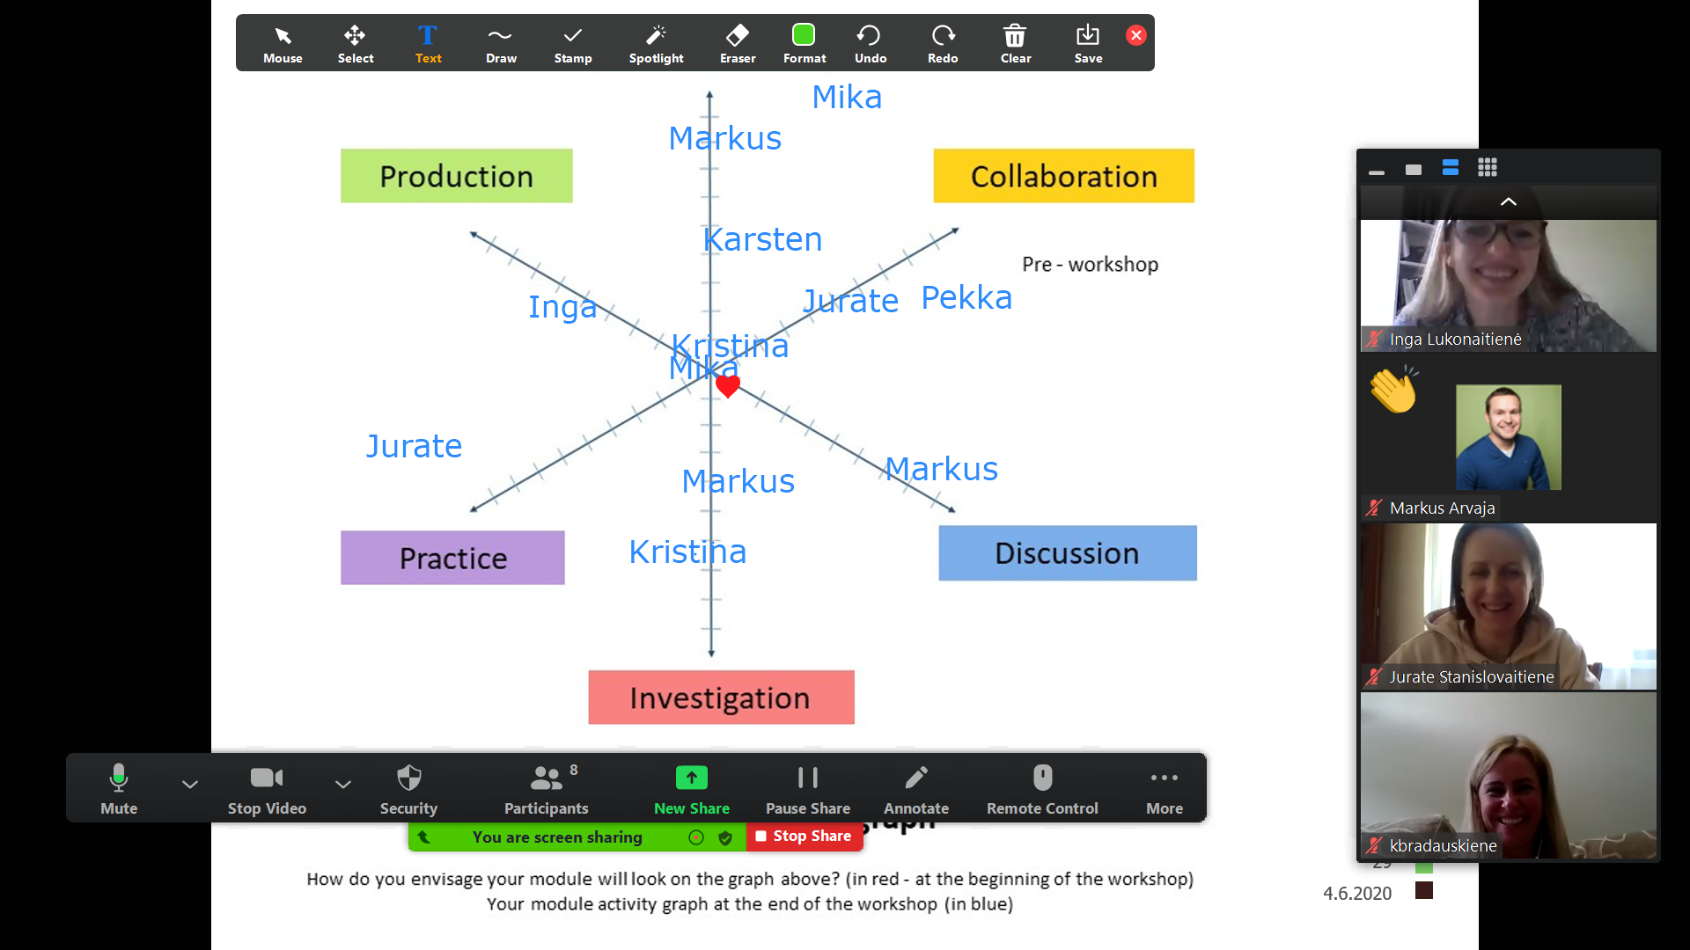

Slide 31
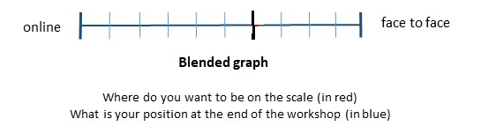
Philosophy and physiology
Human growth and injury prevention
Physical conditioning

Slide 32
Evaluation criterias for e-learning Haaga-Helia
LINK HERE

Slide 33

Arena Blended Connected (ABC) Learning Design workshop action plan
Action plan | Who/when
ABC Learning Design workshop by Clive Young and Natasa Perovic, UCL. (2015).Learning types, Laurillard, D. (2012). Resources available from https://abc-ld.org

Slide 34
