Slide 1

Technical check in
Bring virtual patience
Bring virtual patience
Bring virtual patience
Chech your name and update your name -> (Participants->rename)
Un mute your microphone and say something! What is your own feeling? If you are going to write book from last week what can be the name of the book?
When we are hearing your voice and topic of the book, you can mute your microphone.
Keep your microphone mute position when you are not speaking.
Di yo remember to bring your pre-task here. ☺
Please be present 100 %?
Bring virtual patience!
Relax for moment, we will start 10.00
1

Slide 2

Working principles
Everyone has a responsibility for the success of the workshop.
Respect, listen - don't interrupt!
Use the hand up tool when you want to speak.
Accept that we will not complete the world in this workshop too!

Slide 3

Timetable
Time | Theme
09.45– 10.00 | Technical tuning
10.00 – 10.15 | Welcome and orientation
10.15– 11.00 | To get to know each other
11.00– 11.10 | Break
11.10 | Coaching Philosophy
11.20 | Sport Psychology
11.30-11.40 | Growth and Maturation
11.40-11.50 | Strength and conditioning
11.50-12.00 | Sport Injury Prevention
12.00-12.15 | Next step
12.15 | Technical support (optional)

Slide 4
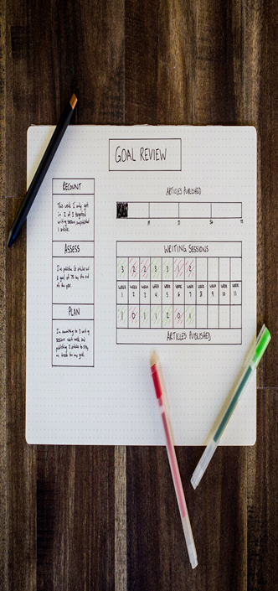
Objectives in this online workshop
You will get to know each other
Course objectives and study process

Slide 5
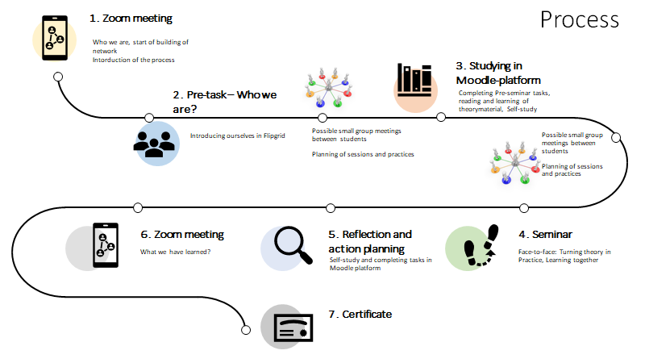

Slide 6
Get to know each other in break out rooms (15 minutes)
TASK:
Take a photo from the picture at next slide
Choose on door which describes your thoughts towards this education process and think why.
Share your thoughts with the group. Tell also:
  your name
  where you come from
  what is your sport

Slide 7
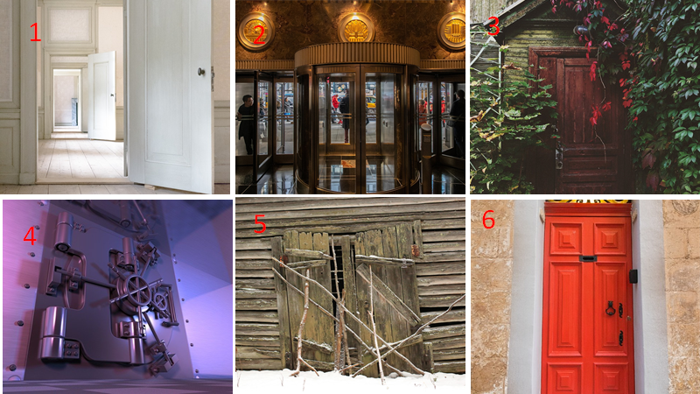

Slide 8
Get to know each other part two - new breakout rooms (15 minutes)
TASK:
Take a photo from the picture at next slide
Choose the picture which kind of learner you are and think why.
Share your thoughts with the group. Tell also:
  your name
  where you come from
  what is your sport

Slide 9
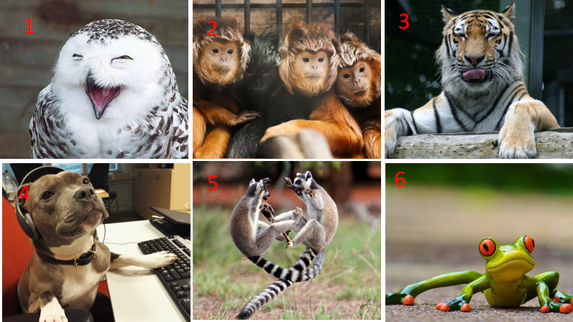

Slide 10
Quick chat
Continue the following sentences in the chat! You have 30 seconds to write. You can only press the send button when permission is given
What kind of experience you have as a coach…..
What kind of expectation you have on this study process…

Slide 11

Break picture from the seminar place
https://youtu.be/d-diB65scQU Don’t Worry, be happy!

Slide 12
Introduction to topics

Slide 13
Coaching Philosophy
Objectives
Pre-task
Picture

Slide 14
Sport Psychology

Slide 15
Next Step
Arrival to
Checklist pretasks
moodle

